Slide 1
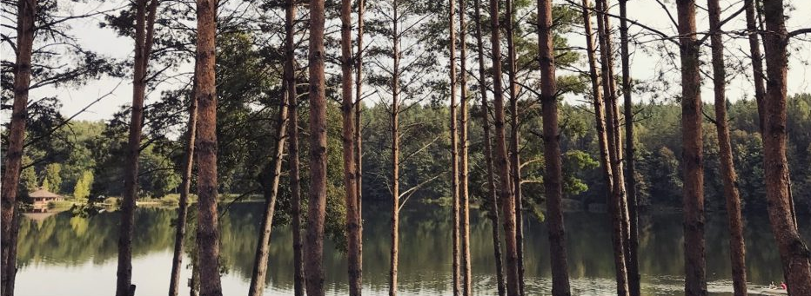
CO2 Challenge
By Vilkaviškio r. Gražiškių gimnazija
Lithuania

Slide 2
CO2 footprint per week
We try to lead eco-friendly way of life as much as possible:
We do not buy unneccessary items, sort out and compost our food waste,
We avoid plastic, take interest in the effect of our lifestyle on the nature,
That is why during this cahllenge we did not change anything, but wanted to actually know what is our real footprint.

Slide 3
My eco-logical way of life

Slide 4
CO2
CO2 or carbon footprint is one of the ways to measure how human activity affects nature.
This impact on nature is evaluated according to the amount of gas causing greenhouse effect.
It is formed when people burn fossil fuel coal, cut foresrs, produce concrete, etc. It is possible to measure the carbon footprint of all the state, separate industry branch or even an individual person.

Slide 5
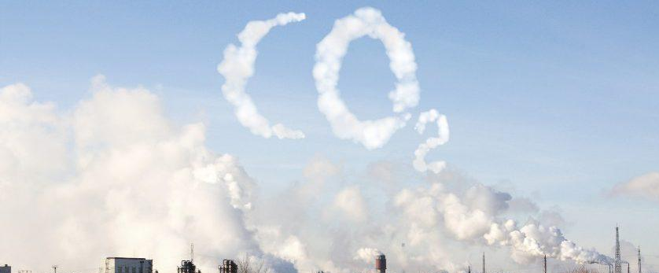
If humankind did not overuse the resources of the Earth, CO2 trace would be unnecessary to be calculated. However, today we have already used our CO2 „budget“ – in the atmosphere there is so much greenhouse gas that the temperature of the surface of the Earth is drastically rising and climate is changing.
According to the Paris Agreement, all the humankind has to try that the average Erath surface temperature does not rise more than 2°C until the end of this century..

Slide 6
My carbon footprint
When I started being interested in my carbon footprint, I understood that the trace is left not only by my mum‘s driven car, but each single thing used by me. Buying any new thing, I become responsible for the amount of CO2 produced while manufacturing and transporting it. That is why calculating my own carbon footprint I know that I have to follow various aspects of my daily life:

Slide 7
How I traced my CO2
Transport. How many kilometres I travelled and what vehicles used?
Electricity. How much electricity did I use at home?
Food. How much and what food did I consume, what is its origin, packaging?
New things. What new things did I buy or get?
Waste. How much non-sorted, sorted and composted waste was there?

Slide 8
How I traced my CO2
First of all, I tried to calculate it myself.
Everything was clear regarding transport and electricity trace: just kilometres driven and electricity meters were recorded.
There are free online websites accessible, e. g. https://bit.ly/3kgIp4A

Slide 9
How I traced my CO2
I did not manage to calculate exactly the rest part – food, things and waste trace myself.
I can only guess how much CO2 was emitted growing, packing and transporting, e. g. plums from South Africa, bananas from America and Africa.

Slide 10
Results
I was surprised by the results – I generated almost 100 kg CO2 per week.
In order to reach the Paris Agreement, the amount of CO2 for one person should be up to 2 tones a year.
The average carbon footprint of a Lithuanian is about 5 tones, and the average American – over 16 tons.
It is important to mention that these averages were calculated how much a country produced CO2 inside the country, but not imported. The results:

Slide 11
Results
Rezultatų suvestinė
Type | Quantity | CO2, kg
Transport | 87,5 km | 12,1
Electricity | 10,1 kWh | 2,1
Food | 9,15 kg | 75,3
New items | 2 vnt. | 5,5
Waste | 2,6 kg | 1,7

Slide 12
Results
It appears that more than three thirds of my CO2 consists of food – more than expected.
Day when I ate mostly food grown and produced in Lithuania – food footprint was about 7 kg, but when the origin country of the day meal was Finland or the Netherlands, the footprint doubled and reached 15 kg.

Slide 13
Results
Transport footprint (12,1 kg) made more than one-tenth of my CO2 footprint. That week I went with my mother not ony to school, but to Vilkaviskis (25 km). sudarė šiek tiek daugiau, nei dešimtadalį mano CO2 pėdsako. At the weekend I travelled to the nearest city Marijampole to have a look at its Christmas tree. During the week I travelled about 88 km (with my mother‘s car and school bus).

Slide 14
Results
That week I got or bought a few new things: T-shirt (4 kg CO2) and dental floss (1,5 kg CO2). That is why the footprint of the items bought is small. However, I also bought a second-hand sweater, but second-hand items do not have CO2. Obviously, instead of buying a new item, we do not leave CO2 footprint while buying a second-hand one.

Slide 15
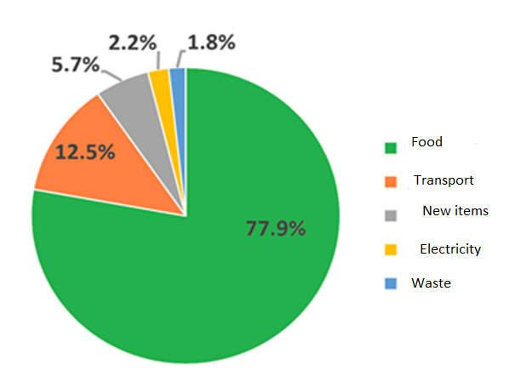
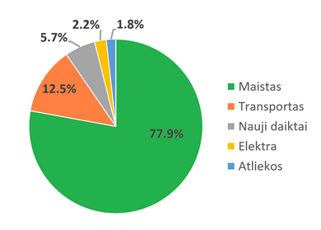
Results
The CO2 footprint of electricity and waste is small but significant – 4 kg CO2.
My CO2 pie

Slide 16
Summary
I have recorded my CO2 footpritn of one week in December. I was surprised by the results, even shocked by the final outcome. But what next?
I am not going to drastically change my way of life, as in that case I would need to completely refuse eating, but here are some thoughts:

Slide 17
Summary
It is important to follow the daily principes of sustainable way of life and not to focus too much on personal carbon footprint. My CO2 footprint is already smaller than earlier. However, it is not necessary to focus all attention to the decrease of CO2 footprint only. Every day we leave not only CO2, but also other footprints – we use water, pollute nature with different waste. Due to our way of life nature suffers. Sometimes items used by us can leave bigger carbon footprint, but be less harmful in other aspect.

Slide 18
Summary
The most important part while aiming to decrease climate change os food. As tracking my carbon footprint showed, the footprint of food took the biggest part of my CO2 pie (over three-thirds). In order to reduce my food footprint, I have to not waste food, use less meat and dairy products, choose mostly local and seasonal production. Still, the footprint of my CO2 (as well as general) will actually decrease when food will be grown more sustainably by all the humankind. It is necessary, as otherwise crops can be harvested only 60 times (until 2080).
There is a very good documentary Kiss the Ground (e. g. Netflix) – in my opinion, it should be watched by everybody.

Slide 20
Resources used:
Documentary „Kiss the Ground“ (2020): https://www.netflix.com/lt/title/81321999
CO2 footprint calculator: https://calculator.carbonfootprint.com/calculator.aspx?lang=lt
Personal ecologic footprint calculator: http://www.footprintcalculator.org/

