Slide 1
RANGERS OF CHANGE
5th K and 6th A grades HOW CAN WE KEEP THE ATMOSPHERE CLEAN

Slide 2
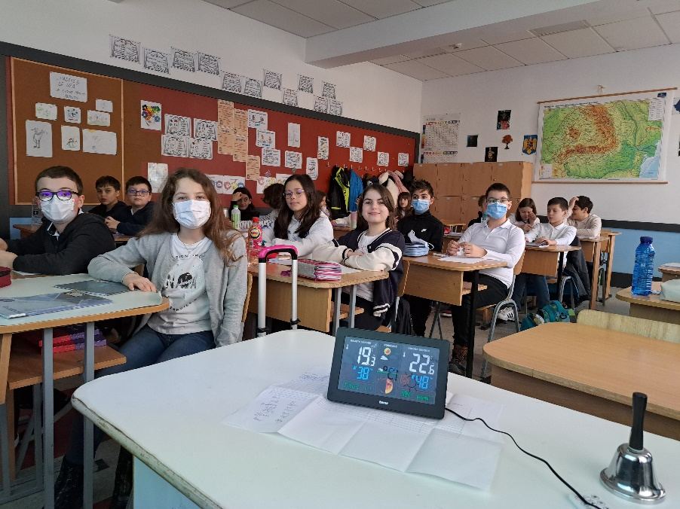
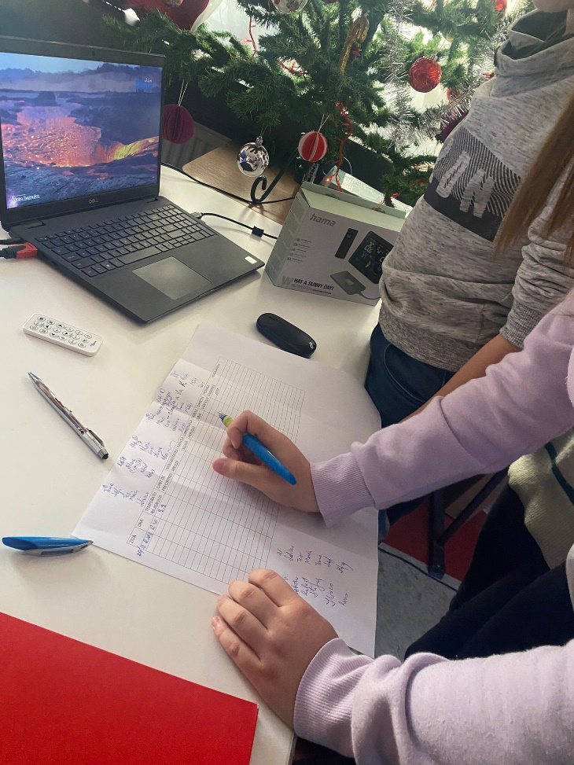
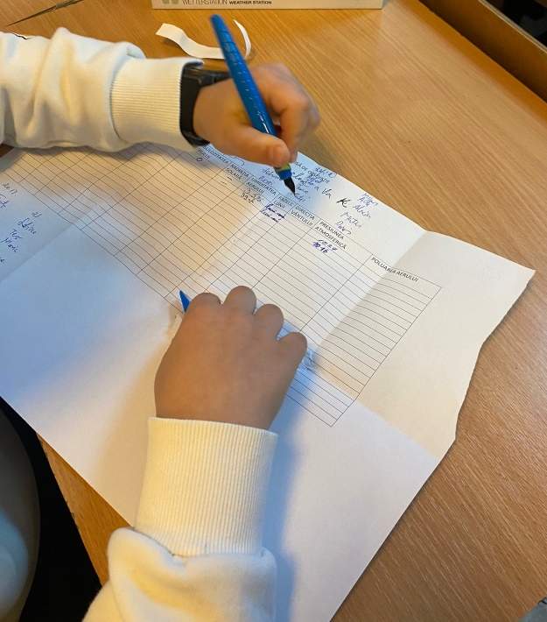
the climatic values ​​of December and January 2022-2023 were measured. There are significant changes, compared to the year 2021-2022

Slide 3
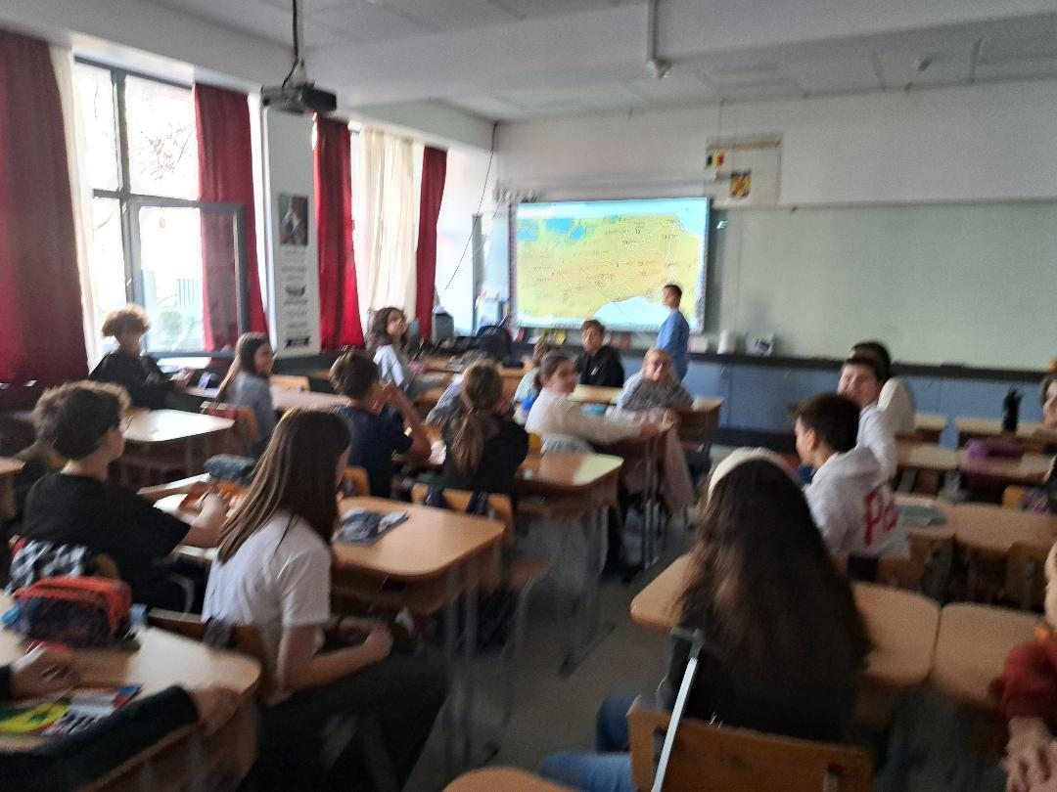
The causes of pollution in the area of ​​our school were identified
the causes?
THE CARS
- TITAN THERMAL POWER PLANT
POLYCOLOR FACTORY –
THE SWITCHBOARDS FROM APARTMENTS/HOUSES

Slide 4
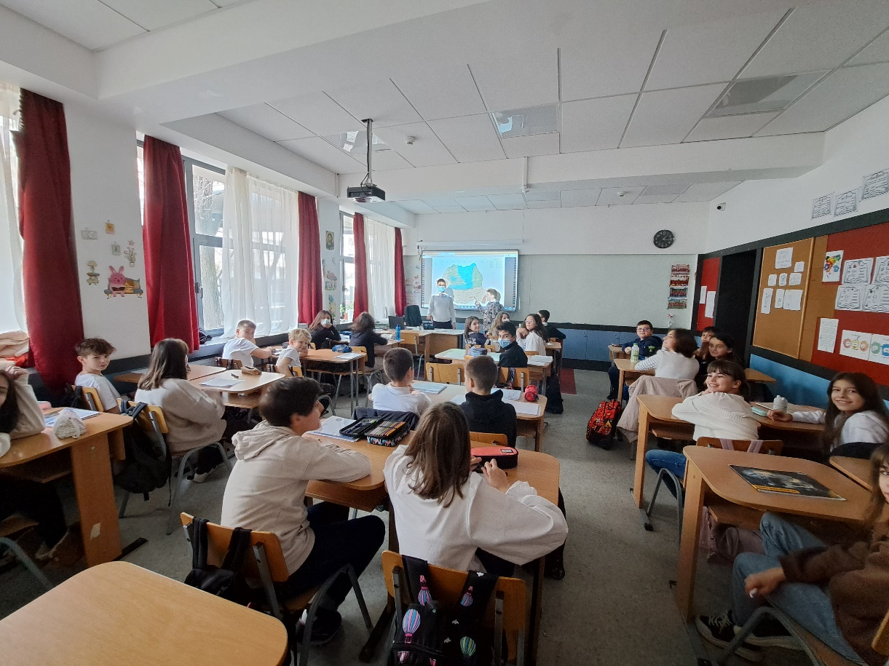
-reduction of noxious emissions in the atmosphere
reducing burns

Slide 5
What can we do? - reduction of burns; replacing hydrocarbon cars with electric cars; -filters at the thermal power plant chimneys

Slide 6
56 students participate in this project.
We are all concerned about major climate changes, changes produced by human activities.
As a conclusion: It is necessary to reduce all emissions in the atmosphere if
we want to give the planet TERRA another chance.
We are the Rangers Of Change!

