Slide 1
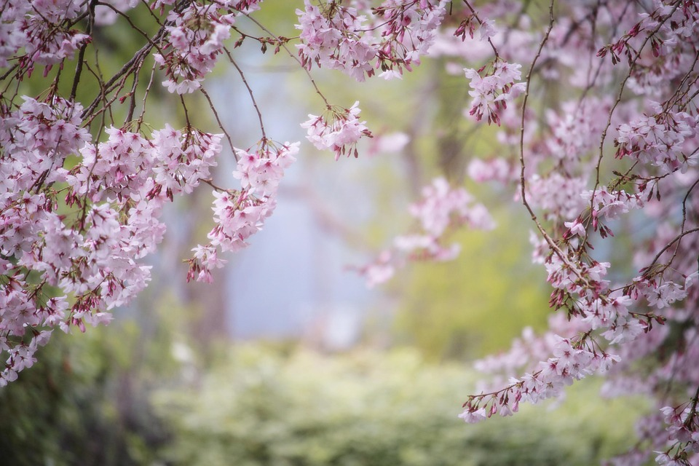
Endangered animals
Bolma Sofia and Serban Teodora

Slide 2
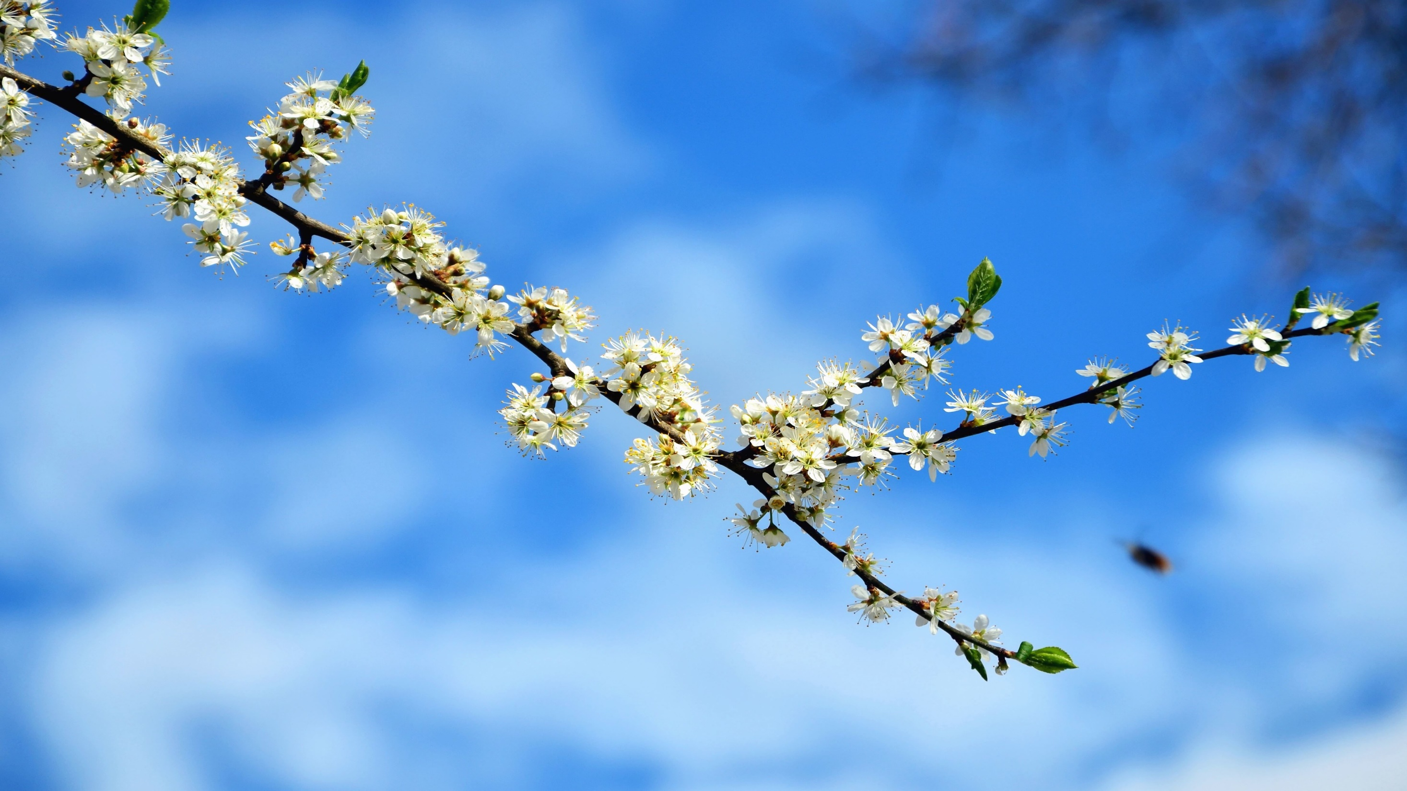
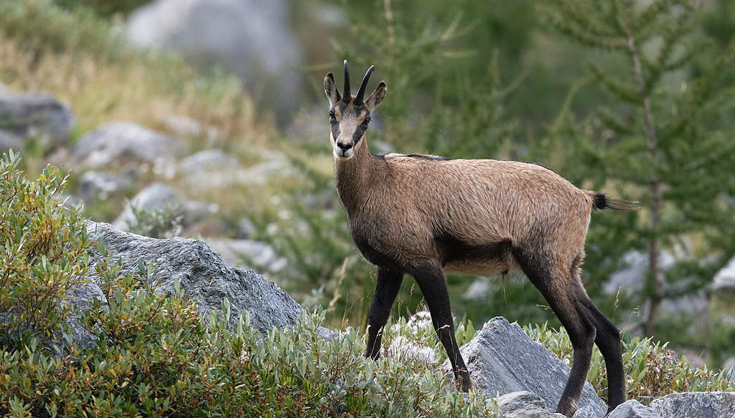
Black Goat
The Animal Lives In Groups Of 15 - 30 Goats Consisting Of Young Goats And Mother Goats. This Social Structure Changes According To The State Of The Season. Their Food Consists Of Alpine Roses, Leaves Of Various Plants, In Winter The Goats Consume Moss lichen

Slide 3
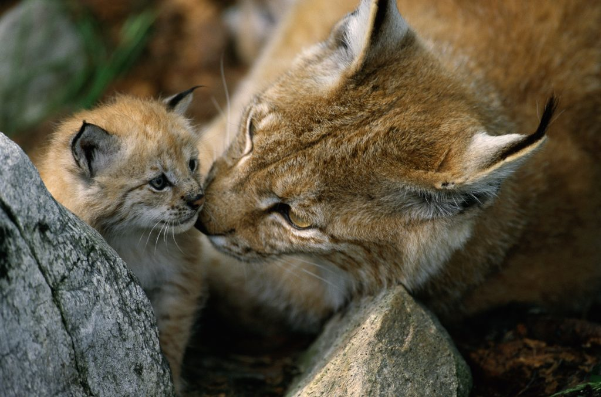
Lynx
The lynx is the biggest cat in Europe. A nocturnal animal, it lives alone and can rarely be seen by humans. It has a slender and strong body, a height of 60-75 cm and a weight of 30 kg, and the ears are extended with a tuft of black hair. The color of the fur is yellowish-brown, and most lynxes have red and even black spots on the back, sides and especially on the legs.

Slide 4
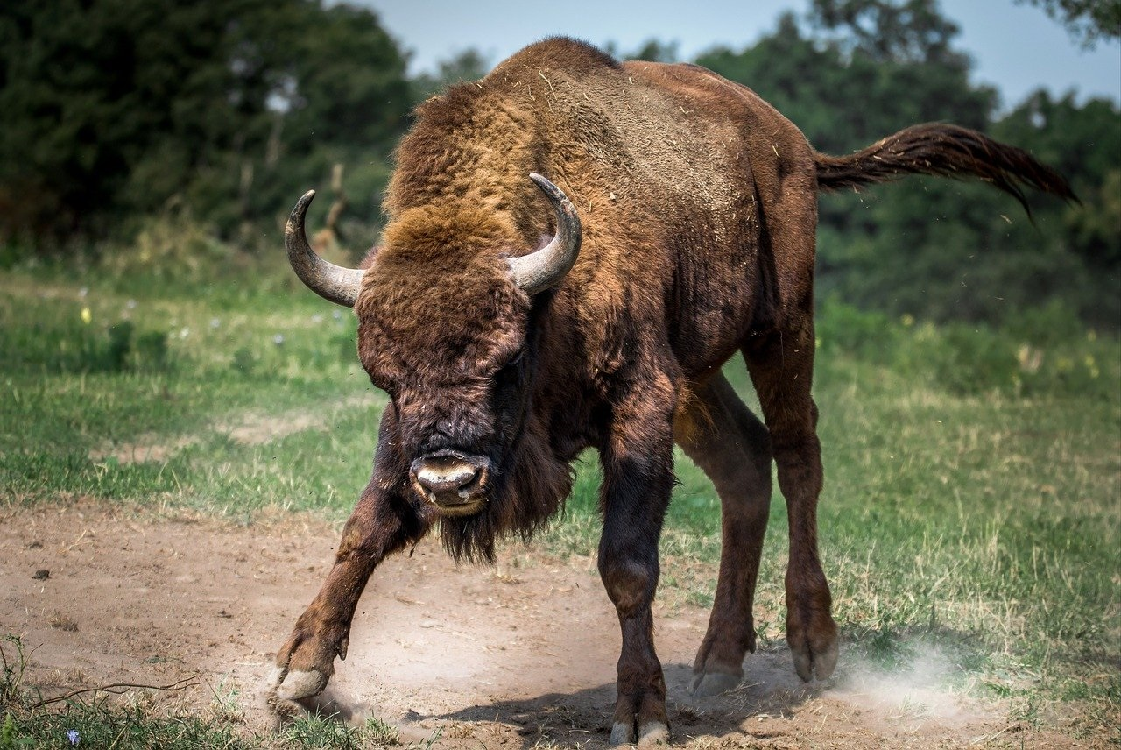
Bison
The bison is an endangered wild animal in Romania. It is the largest land mammal in Europe. It weighs 1,000 kilograms and is over 1.7 meters tall.

Slide 5
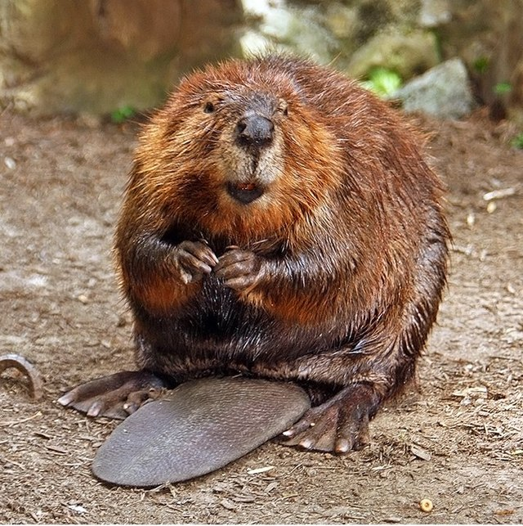
Beaver
Beavers are medium-sized mammals, with a body length of up to 90 cm. The weight of beavers varies, depending on the species, from 10 kg to 31 kg. They have a silky, reddish-brown coat. Beavers have an elongated body with small, strong limbs. Their uncovered tail is large and wide.

Slide 6
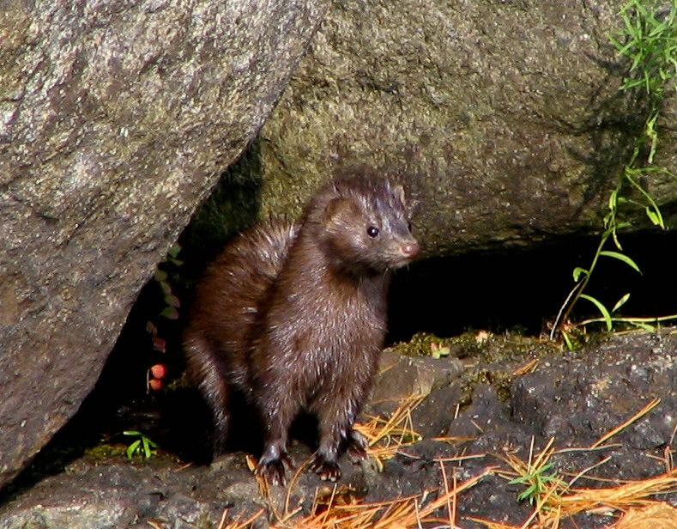
Mink
The mink lives in Spain, France, Romania, Ukraine, Estonia and Russia. The European mink is an endangered species. It has fur. It feeds on aquatic animals and small mammals

