Slide 1

Buy recyclable items

Slide 2
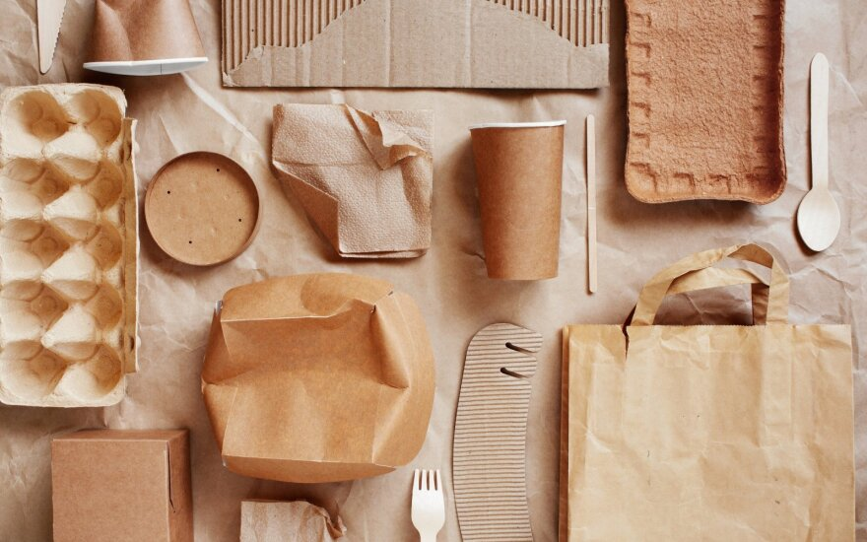
Recycling is a great way to reduce waste. We throw away a lot of garbage every day. When we buy things in the store, we can choose packaging that can be recycled.

Slide 3
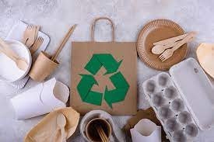
In my opinion, the easiest packaging to recycle is paper. For example, it can be eggs in a paper package. You can use paper bags for buns.

Slide 4
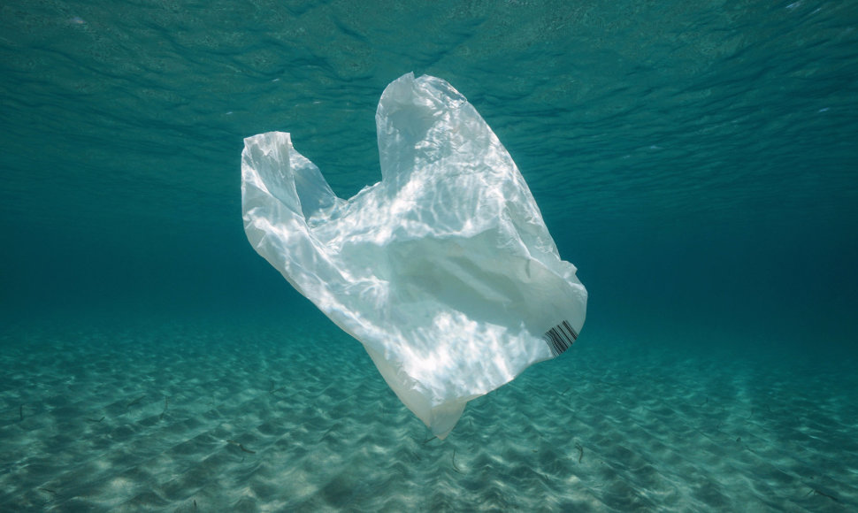
Use plastic bags as little as possible, replace them with paper or reusable ones or use glass containers.

Slide 5

Let's protect our nature, let's think about what we buy!

