Slide 1
Don't buy what you don't need
Created Emilija Krušinskaitė

Slide 2
When buy things/stuff that you don't need it's called oniomania
,

Slide 3
Before buying stuff you got to:
Ask yourself if you really need/want it
Think where you are gonna go with it
If its not urgent, then just think about it for some time
Will it have many uses
Why you are buying this

Slide 4
How to stop shopping addiction :
Set a saving goal to save money and less shop
Seek support from someone to help you less shop
Find other activities
Remove your saved card info

Slide 5
Some things you don't need to buy
No needed clothes
Single use cleaning products
Extra furniture
Something just because it's on sale

Slide 6
When we buy something we don't need, we waste and it's bad for the planet and people

Slide 7
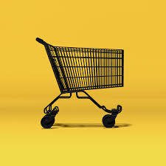
By Emilija Krušinskaitė 7grade

