Slide 1
GREEN DIARY
DIARY

Slide 2
Day 1 to day 3
01
02
03
I opted for sustainable transportation
I minimized food waste
I rode my bike to school
I planned meals, used leftovers to make compost
I tried to save water
I took shorter showers and helped to fix some leaks

Slide 3
WHY I DECIDED TO SAVE WATER?
In light of the severe drought conditions in Spain, I have chosen to conserve water as a measure to address the pressing environmental concerns. The scarcity of water resources poses a significant threat to the ecosystem and agricultural activities in the region. By adopting water-saving practices in my daily life, such as using water-efficient appliances and being mindful of water consumption, I aim to contribute to the collective efforts in mitigating the impact of drought and ensuring a more sustainable use of this vital resource. It is crucial for all of us to play our to help the environment and support long-term water sustainability in Spain.

Slide 4
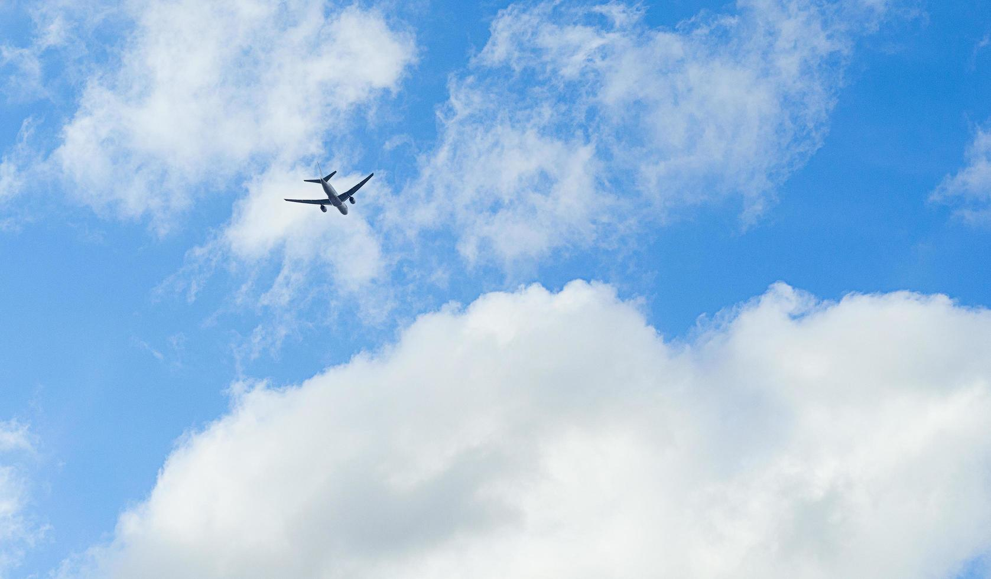
DAY 3 TO DAY 6
I REDUCED AIR POLLUTION
I used public transportation
My family went shopping for local local products
We just bought what we needed

Slide 5
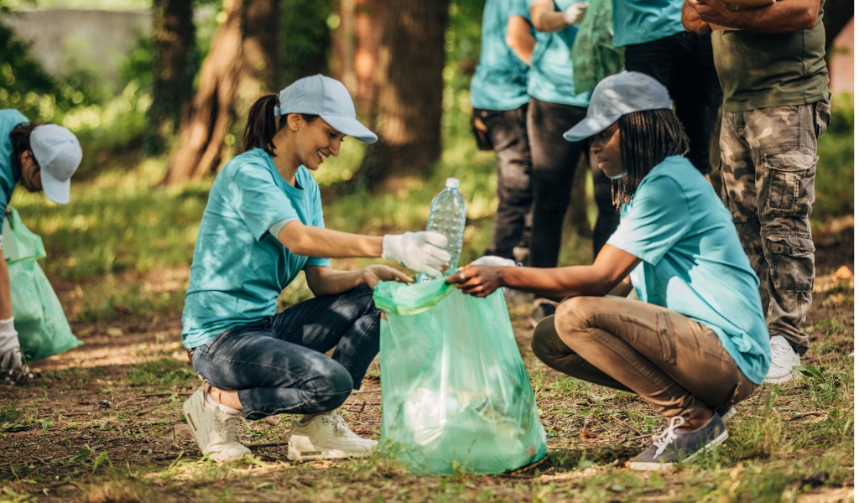
DAY 6 TO DAY 9
I volunteered for environmental
causes
I talked to my classmates about the importance of protecting the environment

Slide 6
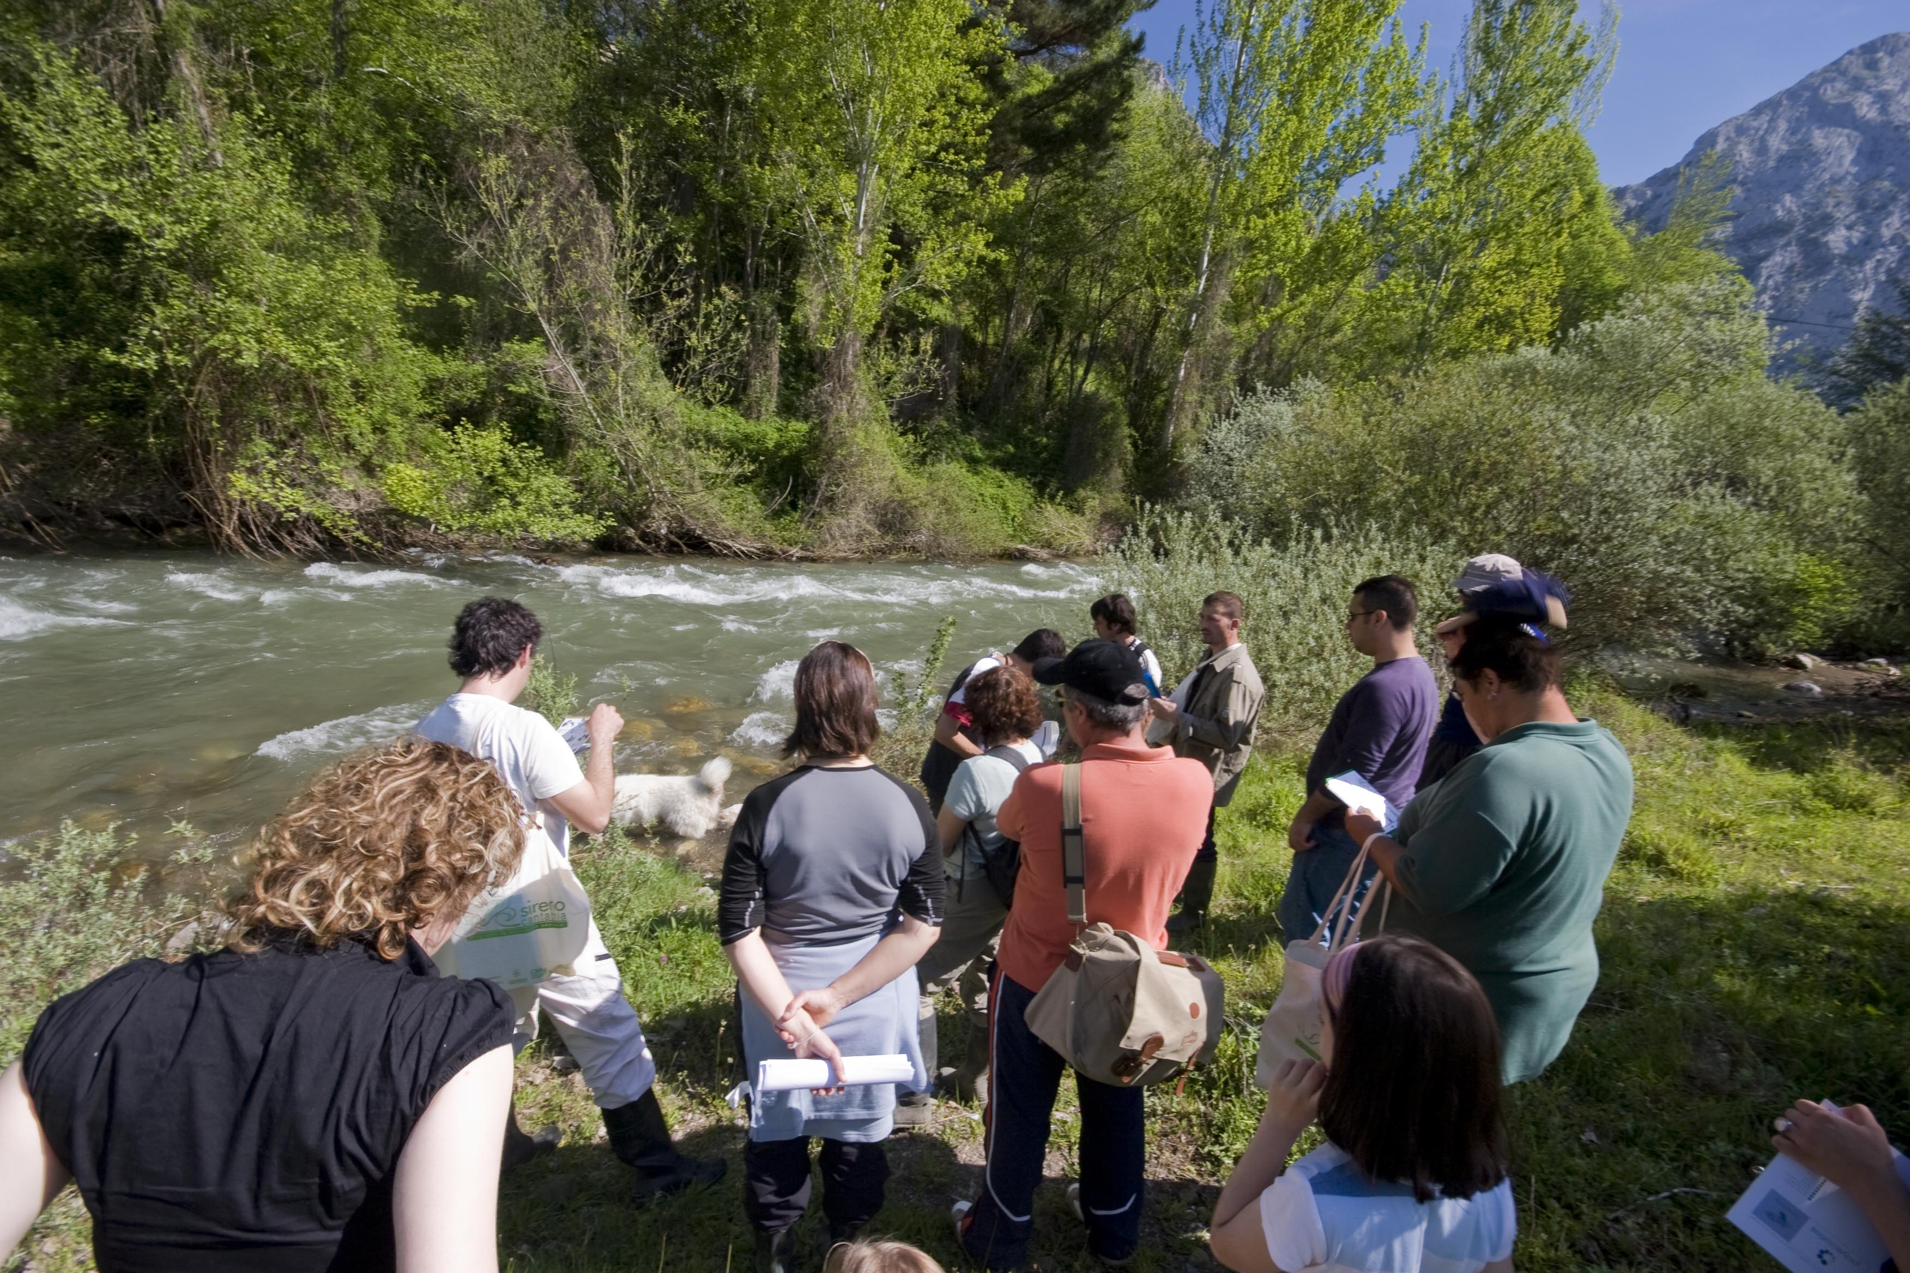
DAY 9 TO DAY 12
I REDUCED LIGHT POLLUTION
I ENGAGED IN COMMUNITY CLEAN -UPs
I used indoor lighting only when necessary
I help to organised alocal clean-up

Slide 7
DAY 12 TO DAY 15
I PRACTISED RESPONSIBLE WASTE MANAGEMENT
I SUPPORTED LOCAL AND SUSTAINABLE BUSINESSES

Slide 8
DAY 15 TO DAY 18
I REDUCED PLASTIC and paper WASTE
I CONSERVED ENERGY
I PLANTED TREES
I bought reusable bags
I turned off lights and used energy-efficient appliances

Slide 9
DAY 18 to Day 20
My family and I visited the local kennel in the afternoons and watched wildlife documentaries

