Slide 1
MY GREEN DIARY
.
Marta Reguillo Gallego 2ºA

Slide 2
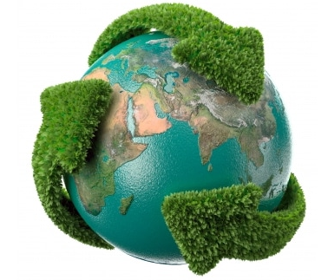
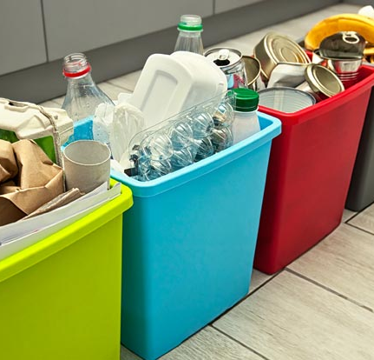
December 1st
Today I took a short shower to save wáter.
I talked to my family about the environment.
I sorted and recycled rubbish.

Slide 3
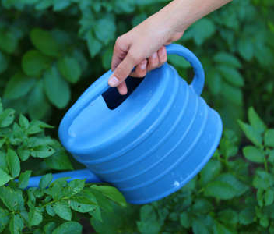
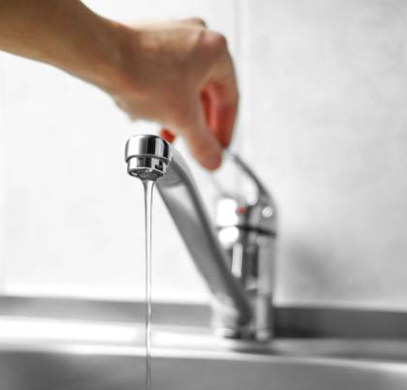
December 2nd
I wrote an essay about the environment.
I turned off the tap while brushing my teeth.
I watered the plants in the garden with rainwater.

Slide 4
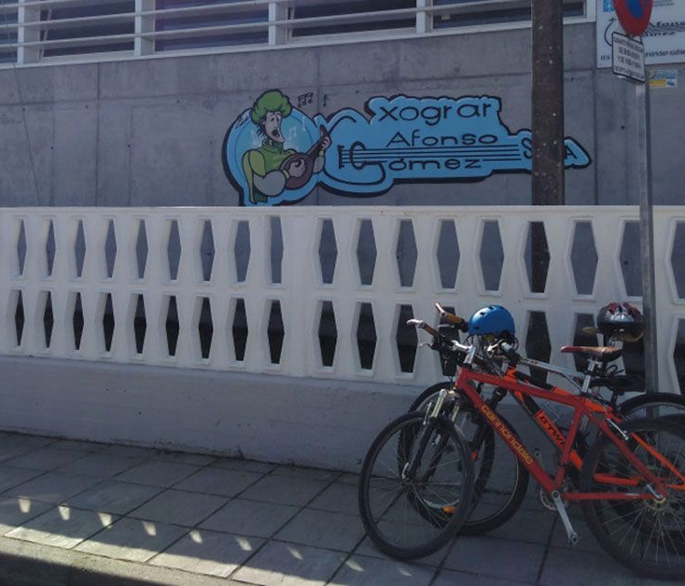
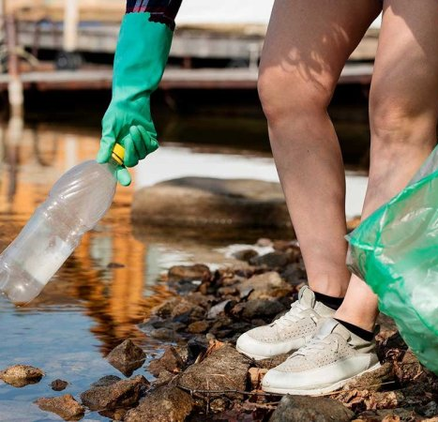
December 3rd
I picked up litter from the street.
I cycled to school.

Slide 5
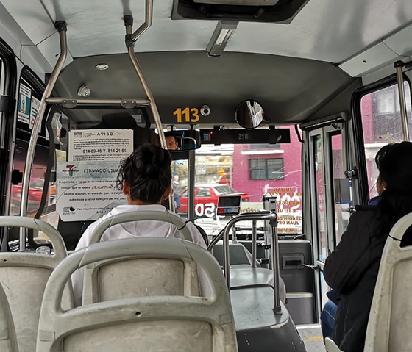
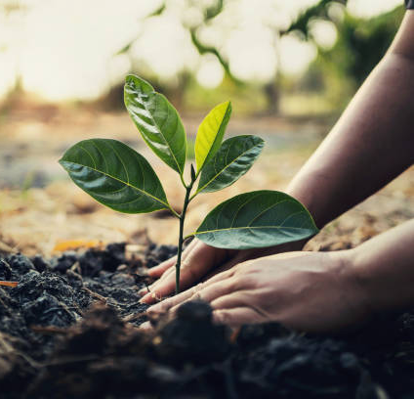
December 4th
I took the bus to after-school activities.
I planted some beans in my garden.
I explained to my little cousin how to protect bees.

Slide 6
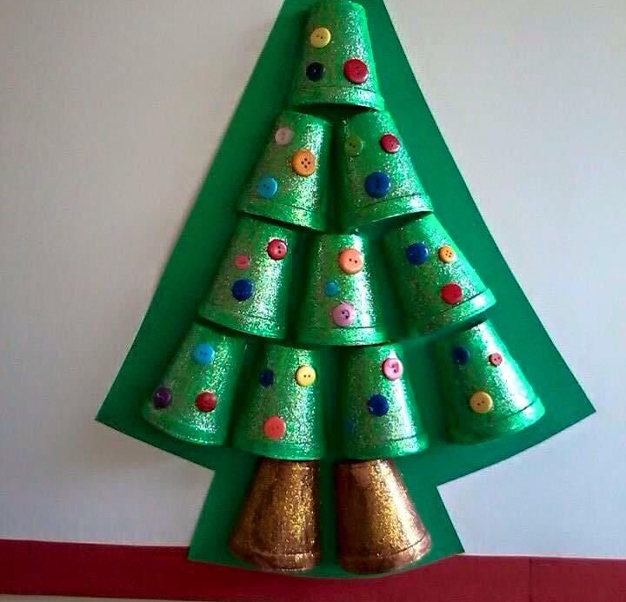
December 5th
I watched a documentary about the ocean.
I made Christmas decorations out of recycled things.

Slide 7
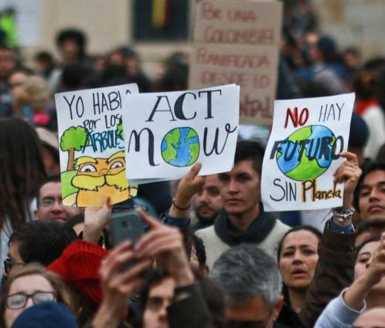
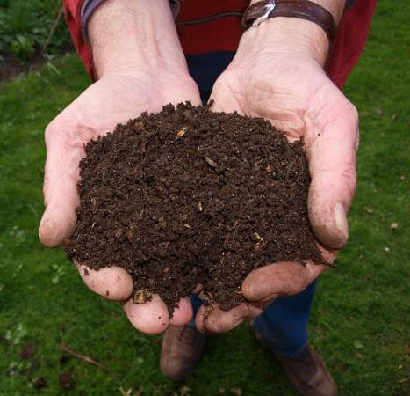
December 6th
I made compost.
I volunteered to reforest with my community.
I participated in a demonstration.

Slide 8
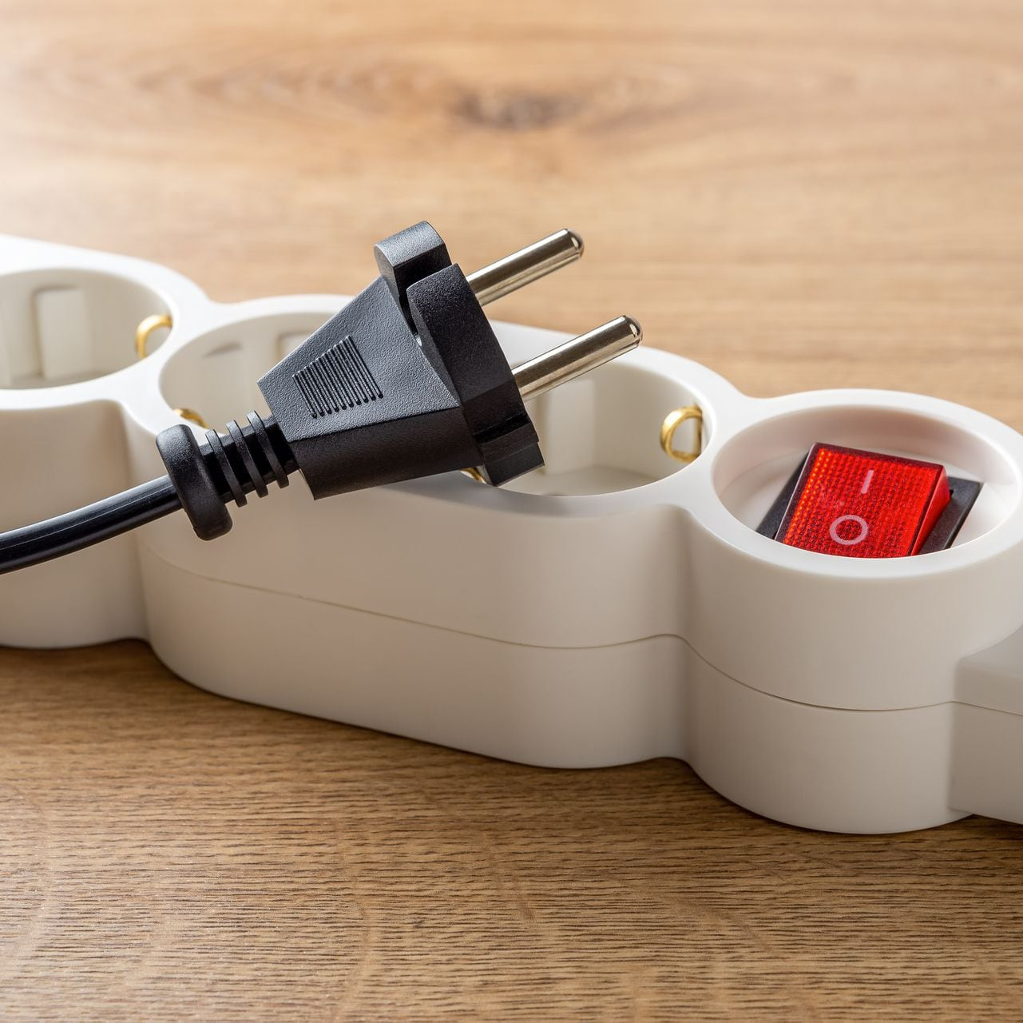
December 7th
I unplugged electronic devices to save energy.
I had a shower to save water.

Slide 9
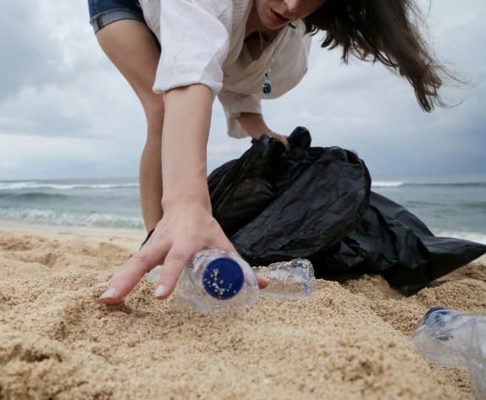
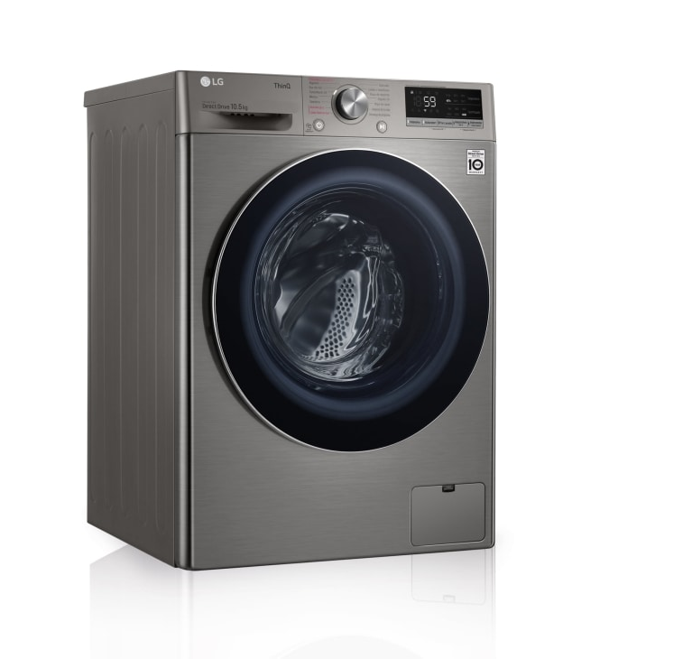
December 8th
I put all the clothes in the washing machine so as not to waste energy.
I went to the beach to collect trash.

Slide 10
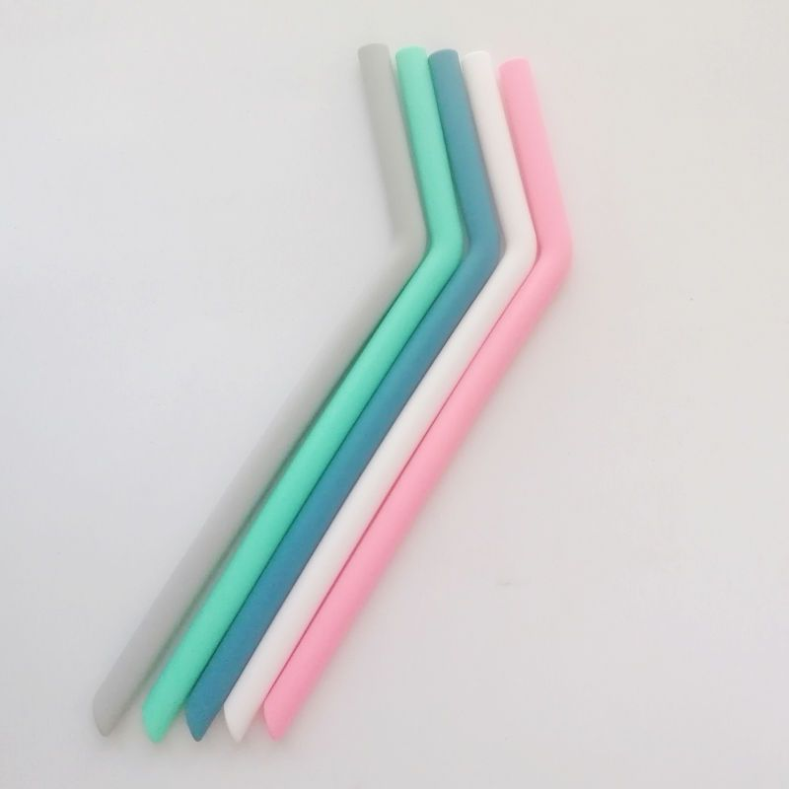
.
December 9th
I read a book about making compost.
I bought some reusable straws.

Slide 11
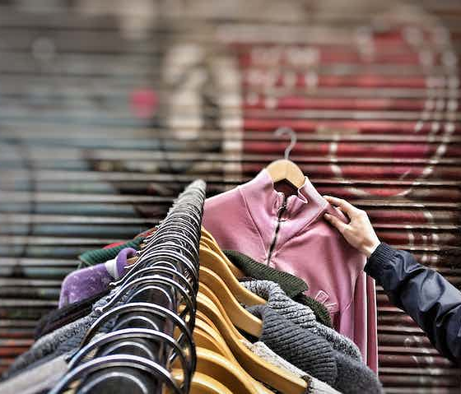
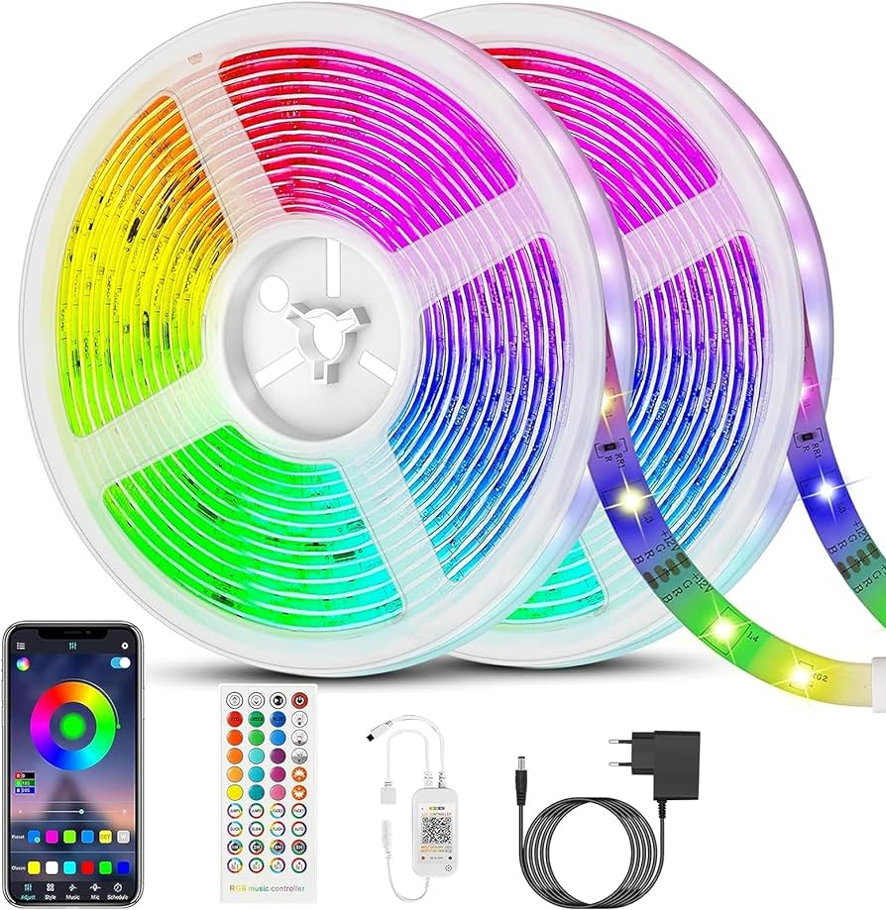
December 10th
We installed led lights.
I took a short shower.
I bought a second-hand coat.

Slide 12
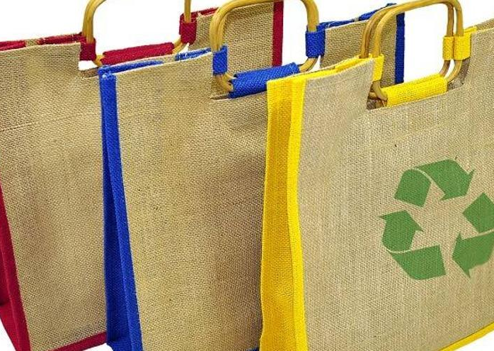
December 11th
I went shopping and used reusable bags.
I went shopping and didn´t buy a beautiful coat. because I don´t need it.
I made a compost.

Slide 13
,
December 12th
I bought some second-hand boots.
I decorated my house with recycled things.

Slide 14
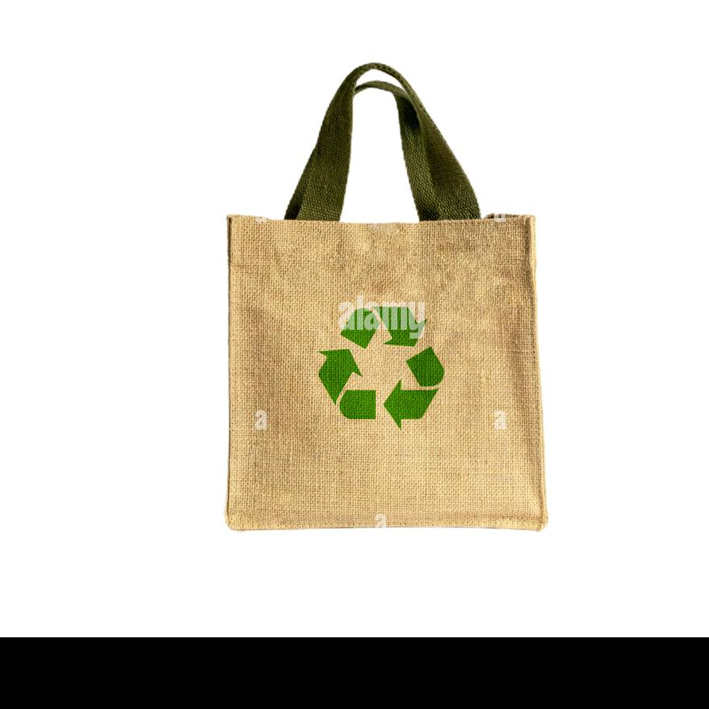
December 13th
I took my own reusable bags to the supermarket
I used organic waste to make compost.

Slide 15
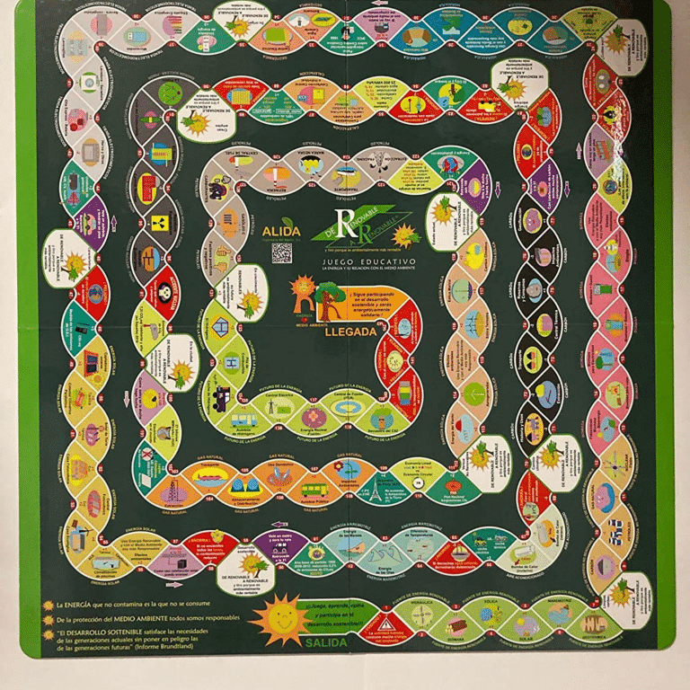
December 14th
I made a gift out of used things.
I bought my cousin a game about the environment.

Slide 16
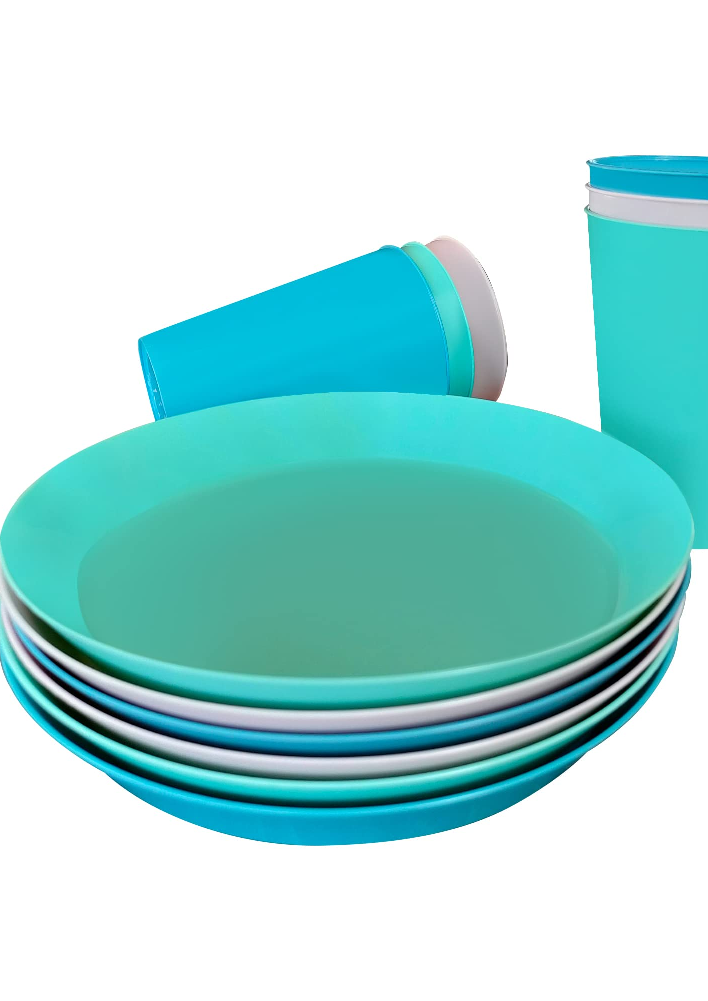
December 15th
I used reusable cups and plates.
I explained to my brother what will happen if we do not take care of the environment.

Slide 17
^{December 16th}
I advised my friends not to use their cell phones so much.
And I also advised them to turn off their cell phones at night.

Slide 18
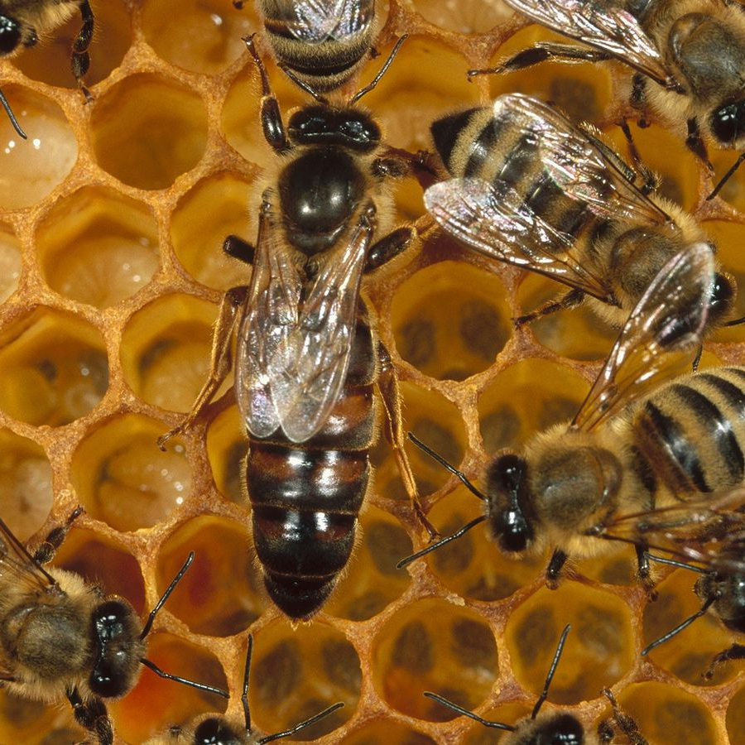
December 17th
I explained to my little cousin how to the protect bees.
and we watch a documentary about it.

Slide 19
December 18th
I went to a lecture and collected rubbish all around.
I collected litter from the street.

Slide 20
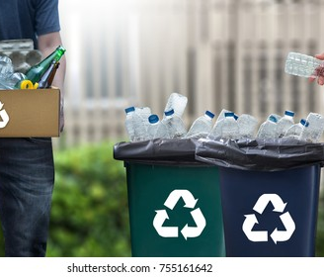
^{December 19th}
I went recycling with my friends.
I took the bus with my friends.

Slide 21
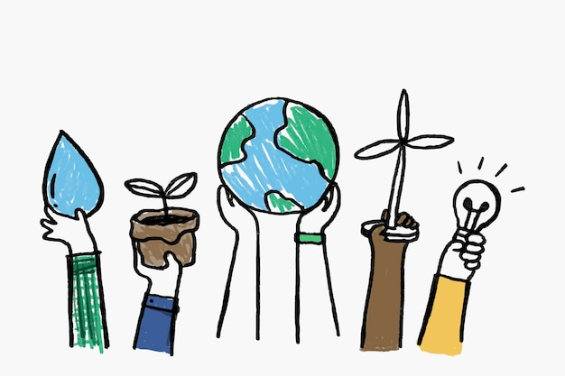
.
December 20th
I have finally finished this diary. I hope it will help raise awareness of good habits and the importance of looking after the environment.

