Slide 1
RANGERS OF CHANGE "Greening minds for a brighter future.“
By José Ignacio Ruiz
Pablo Benito

Slide 2
Dear Headmaster,
We are writing to you to suggest some ideas to stop climate change.
As students, we would like to present you with some of our proposals in the following slides.

Slide 3
First
Promote sustainable transportation.
To avoid traffic jams, reduce pollution and improve people's health.

Slide 4
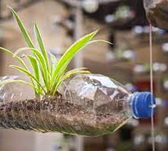
Second
Manage our waste sustainably.
We need to reuse, find new uses for things and/or new ways of consuming the same things.

Slide 5
Third
Save water.
We must try to turn off the tap when we do not need it, thus avoiding wasting one of our most precious resources by having some students ckeck the students’ toilets during the breaks.

Slide 6
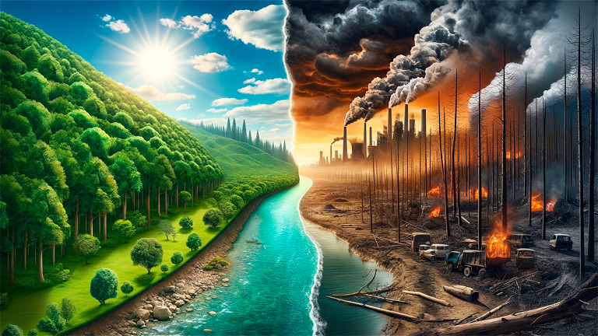
THANK YOU!

