Slide 1
RANGERS OF CHANGE
"Inspiring eco-conscious generations"
by Arantxa Serrano, Sofía Kabbour and Sheila Yáñez

Slide 2
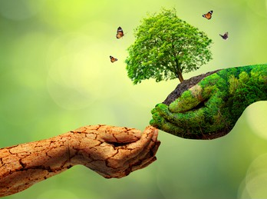
INTRODUCTION
All the biology students at IES Eladio Cabañero have decided to demand some measures to combat climate change.

Slide 3
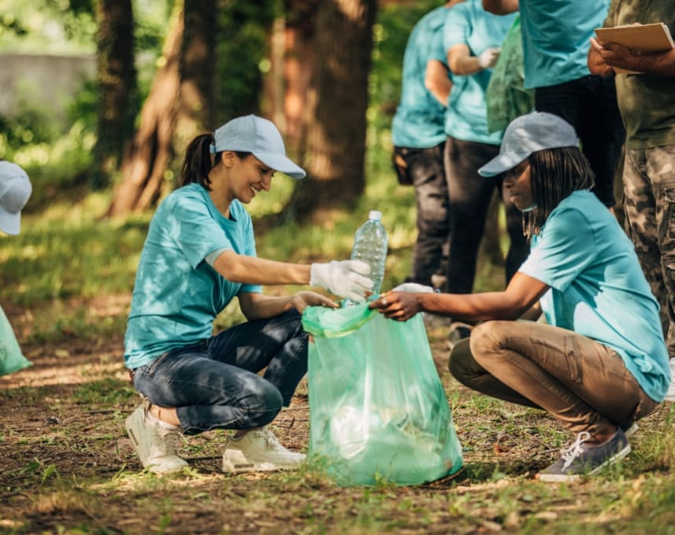
ENVIRONMENTAL EDUCATION
The school should include an environmental education subject in the curriculum. This would help raise pupils' awareness of climate change and its consequences.

Slide 4
2. DO PROYECTS ABOUT ENVIRONMENT
Get involved in student participation in projects such as planting trees or creating sustainable gardens

Slide 5
3. MORE RECYCLING BINS
There should be recycling bins every few metres. This will make recycling almost inevitable.

Slide 6
THANK YOU!

