Slide 1
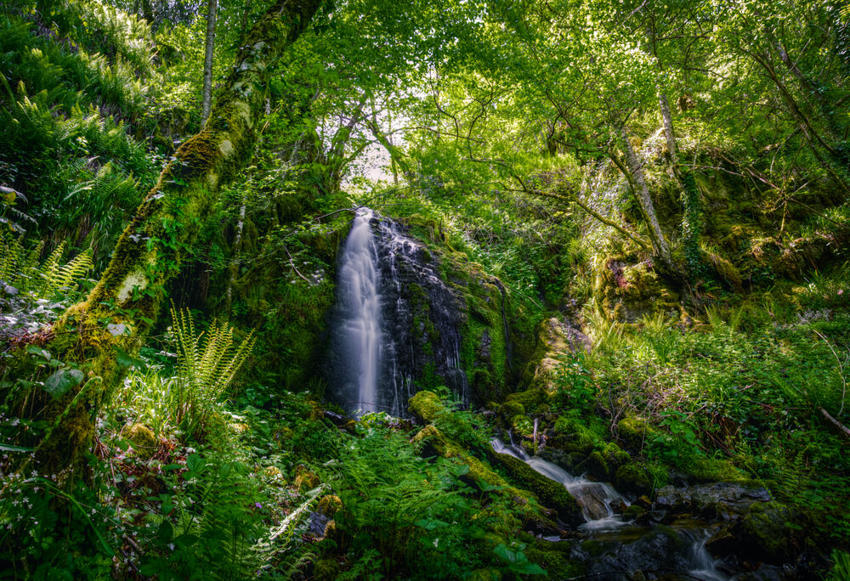
Proposals for the headmaster ”Reducing our footprint, expanding our horizons."
By Catalina Maestre Macías.

Slide 2
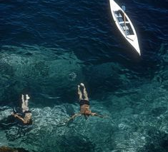
introduction
We are about 500 students in our school. Not a huge number of people compared to the 8 billion people living on our planet. Still, we can make a difference by doing small things that we pass on to the next generations and set an example for the rest of the schools in our town, Tomelloso and, hopefully, for the rest of the world.Even though there are some projects about climate change being carried out, we can always do more. Here are my proposals for the headmaster.

Slide 3
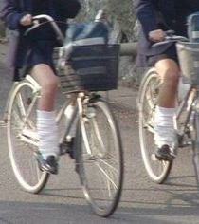
Use the bicycle!
Sometimes students just need a little motivation to do something, so I thought maybe you could talk to PE teachers about rewarding walking or cycling to school for extra credit.

Slide 4
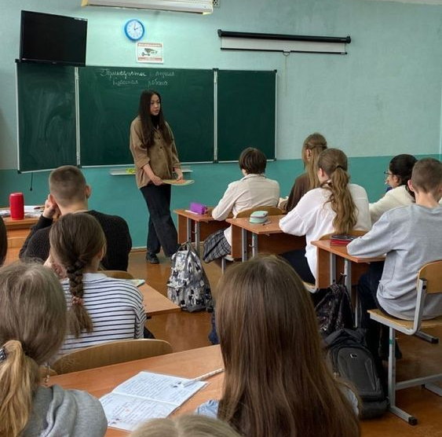
2. Activities TO HELP THE environment
Yes, we talk about the importance of our actions on the planet, but I would like to promote the idea of more talks and workshops where experts tell us what we can do to save our planet and where students can see and experience how easy it is to make a difference.

Slide 5
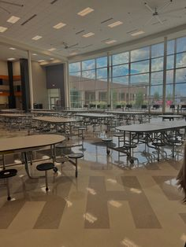
3. more recycling bins
Students spend their breaks outside the building. We have bins inside the building on the first floor next to the school canteen, but not outside. There should be more bins in those areas

Slide 6
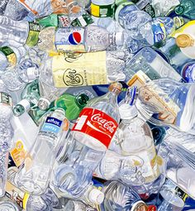
4. RECYCLING GUIDE.
There should be a guide in the school canteen telling us which bin to put what we buy there. For example, cans go in the yellow bin.

Slide 7
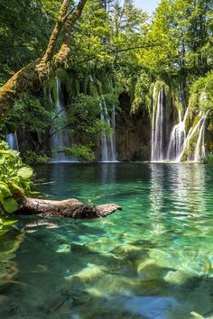
THANKS FOR YOUR ATTENTION!
I hope that you will consider my proposals

