Slide 1
Explaining
Climate Change
by Christos Adam
Impacts and Actions

Slide 2
Explaining
Climate Change
Impacts and Causes
by Christos Adam

Slide 3
What is Climate Change?
Climate change refers to long-term shifts in temperatures and weather patterns. These shifts may be natural, such as through variations in the solar cycle. But since the 1800s, human activities have been the main driver of climate change, primarily due to burning fossil fuels like coal, oil and gas. Burning fossil fuels generates greenhouse gas emissions that act like a blanket wrapped around the Earth, trapping the sun’s heat and raising temperatures.

Slide 4
What is Climate Change?
Climate change refers to long-term shifts in temperatures and weather patterns. These shifts may be natural, such as through variations in the solar cycle. But since the 1800s, human activities have been the main driver of climate change, primarily due to burning fossil fuels like coal, oil and gas. Burning fossil fuels generates greenhouse gas emissions that act like a blanket wrapped around the Earth, trapping the sun’s heat and raising temperatures.

Slide 5
Results of Climate Change
CARBON DIOXIDE
GLOBAL TEMPERATURE
419 parts per million
1.01
°C since 1880
SEA LEVEL
ARCTIC SEA ICE MIN. EXTENT
4
Inches since January 1993
12.6
Percent per decade since 1979

Slide 6
Results of Climate Change
CARBON DIOXIDE
GLOBAL TEMPERATURE
419 parts per million
1.01
°C since 1880
SEA LEVEL
ARCTIC SEA ICE MIN. EXTENT
4
Inches since January 1993
12.6
Percent per decade since 1979

Slide 7
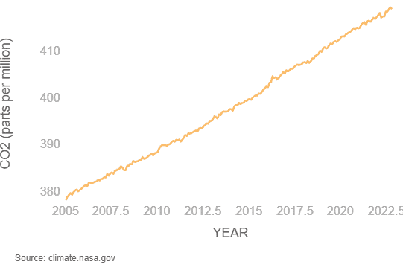
CARBON DIOXIDE
Carbon dioxide (CO₂) is an important heat-trapping gas, or greenhouse gas, that comes from the extraction and burning of fossil fuels . Since the beginning of industrial times (in the 18th century), human activities have raised atmospheric CO₂ by 50% – meaning the amount of CO₂ is now 150% of its value in 1750. This is greater than what naturally happened at the end of the last ice age 20,000 years ago.

Slide 8
CARBON DIOXIDE
Carbon dioxide (CO₂) is an important heat-trapping gas, or greenhouse gas, that comes from the extraction and burning of fossil fuels . Since the beginning of industrial times (in the 18th century), human activities have raised atmospheric CO₂ by 50% – meaning the amount of CO₂ is now 150% of its value in 1750. This is greater than what naturally happened at the end of the last ice age 20,000 years ago.

Slide 9
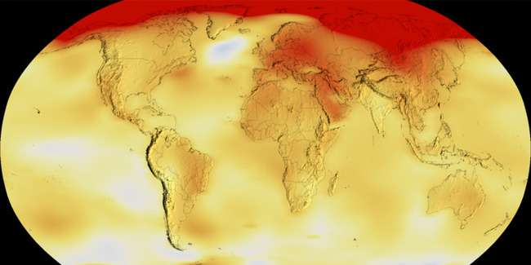
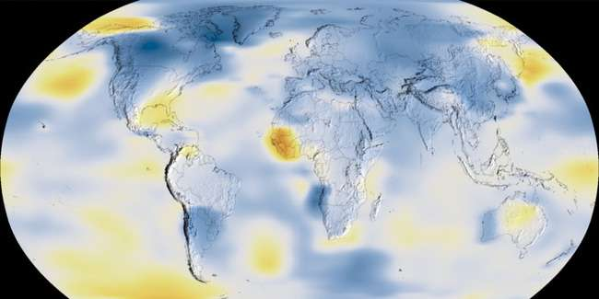
GLOBAL TEMPETARURE
(Average Temperatures in 2020)
(Average Temperatures in 1884)
The animations show the change in global surface temperatures. Dark blue shows areas cooler than average. Dark red shows areas warmer than average. The year 2020 tied with 2016 for the hottest year on record since recordkeeping began in 1880

Slide 10
GLOBAL TEMPETARURE
(Average Temperatures in 1884)
(Average Temperatures in 2020)
The animations show the change in global surface temperatures. Dark blue shows areas cooler than average. Dark red shows areas warmer than average. The year 2020 tied with 2016 for the hottest year on record since recordkeeping began in 1880

Slide 11
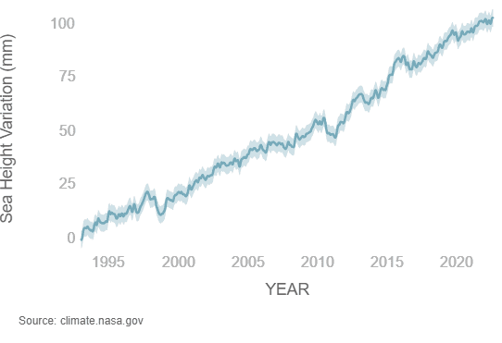
SEA LEVEL
Sea level rise is caused primarily by two factors related to global warming: the added water from melting ice sheets and glaciers, and the expansion of seawater as it warms. The first graph tracks the change in global sea level since 1993, as observed by satellites.
(This graph tracks the change in sea level since 1993)

Slide 12
SEA LEVEL
Sea level rise is caused primarily by two factors related to global warming: the added water from melting ice sheets and glaciers, and the expansion of seawater as it warms. The first graph tracks the change in global sea level since 1993, as observed by satellites.
(This graph tracks the change in sea level since 1993)

Slide 13
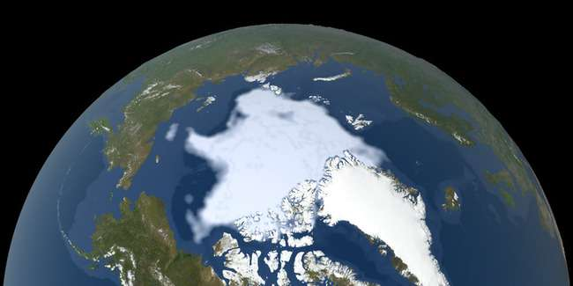
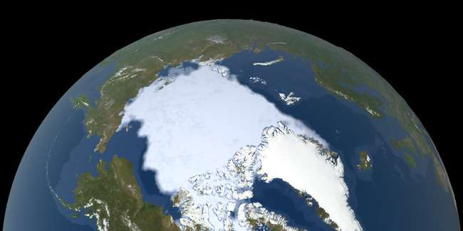
ARCTIC SEA ICE MIN. EXTENT
(The size of the Arctic sea in 2022)
(The size of the Arctic sea in 1979)
Arctic sea ice reaches its minimum extent each September. Arctic sea ice is now shrinking at a rate of 13% per decade. The animated maps above shows the minimum size of the Arctic sea ice measured in 1979 and 2022 based on satellite observations. The 2012 sea ice extent is the lowest in the satellite record.

Slide 14
ARCTIC SEA ICE MIN. EXTENT
(The size of the Arctic sea in 1979)
(The size of the Arctic sea in 2022)
Arctic sea ice reaches its minimum extent each September. Arctic sea ice is now shrinking at a rate of 13% per decade. The animated maps above shows the minimum size of the Arctic sea ice measured in 1979 and 2022 based on satellite observations. The 2012 sea ice extent is the lowest in the satellite record.

Slide 15
Sources of information
THANKS FOR WATCHING
1) https://www.un.org/en/climatechange/what-is-climate-change
2) https://climate.nasa.gov/
3) https://www.who.int/health-topics/climate-change#tab=tab_1
4) https://www.copernicus.eu/en/copernicus-services/climate-change

Slide 16
Sources of information
1) https://www.un.org/en/climatechange/what-is-climate-change
2) https://climate.nasa.gov/
3) https://www.who.int/health-topics/climate-change#tab=tab_1
4) https://www.copernicus.eu/en/copernicus-services/climate-change
THANKS FOR WATCHING

