Slide 1
A true story, about extreme weather phenomena that occurred in Greece.
By Marilena Papadopoulou
& Maria Bechtsi

Slide 2
Major problems were caused by an intense storm and hailstorm in Thessaloniki on Thursday, May 10, 2018. Shops and roads were flooded, while areas were left without water and electricity. The roads were blocked because of traffic jams. The Fire Department received hundreds of calls for pumping water and extricating people.
One of the calls was for the release of visitors to the White Tower, who due to the storm and the accumulation of water at the main entrance could not leave. Those that were trapped were students and tourists who visited the White Tower and finally got out through a ground-floor window, after firefighters had previously chainsawed its railings.

Slide 3
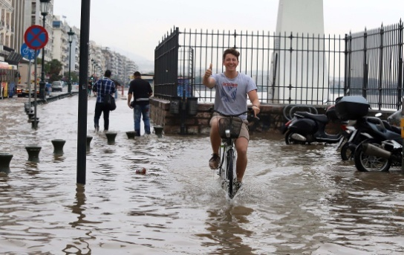
One of the tourists that was trapped there, was interviewed by a Greek channel and he confessed that when they were in there, they would get very terrified because they couldn’t hear or see what was happening outside. Based on what the tourist said, they were waiting for many hours for them to be saved but everyone remained calm and in good health.
I’m good now guys!

Slide 4
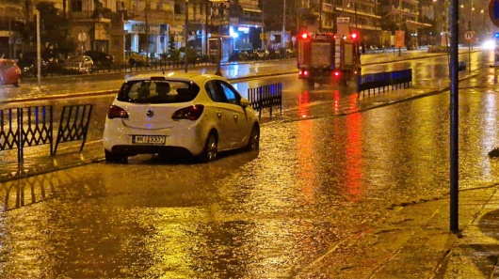
Now let’s talk about the causes of floods…
As a natural phenomenon, floods cannot be prevented. Careless human activity is an important factor in floods, as it is a result of heavy rainfall, melting snow, etc. The pollution of the environment resulting from climate change directly affects the consequences of floods, since it increases their intensity and sometimes prevents their possible prediction.

Slide 5
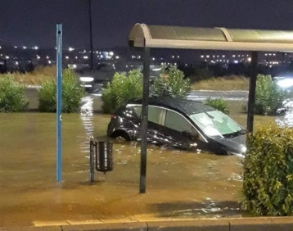
Floods usually have primary and secondary consequences :
Primary consequences include:
– damage or partial/total destruction of bridges, vehicles, buildings, houses, communication systems, drainage systems, road networks and other basic infrastructure.
– losses: drowning of people or animals, as well as causing epidemics and diseases.

Slide 6
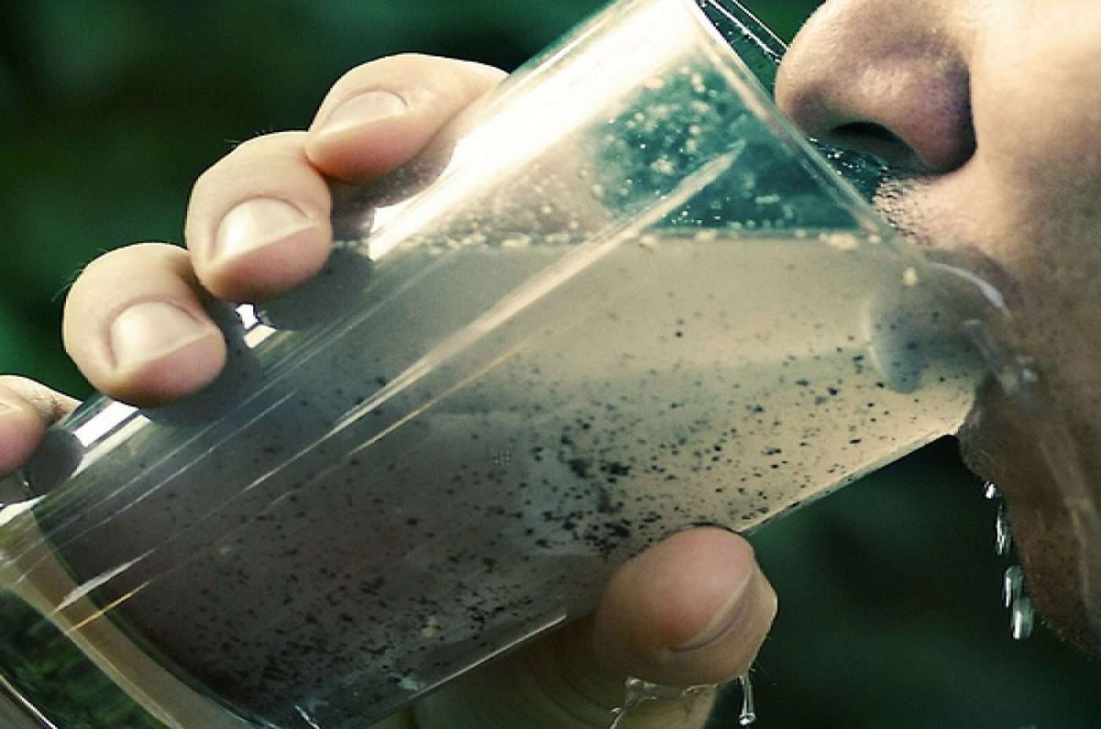
Secondary effects include:
– more difficult water supply due to its contamination, resulting in a lack of clean drinking water.
– more difficult food supply, resulting in food shortages. Entire crops can be destroyed.
– vegetation: many species may become extinct.
– the consequences of floods are long-lasting.
– economic distress due to a
temporary decrease in tourism,
rising food prices and
restoration costs.

Slide 7
Sources
https://besafenet.net/el/hazards/floods/
https://www.hc-crete.gr/tmp/odhgoi/flood.pdf
https://www.philenews.com/eidiseis/ellada/article/524156/-boyliaxe-i-thessaloniki-plimmyres-kai-egglobismoi-binteo

