Slide 1
Green shopping guide
Ardelean Stefan
Duse Damian
Chirea Tudor

Slide 2
3 lists of fruits & vegetables to eat for breakfast/lunch/ dinner
Breakfast:Yogurt and fruit parfaits
Yogurt provides calcium, an important mineral for strong bones, making it a great addition to your breakfast
Lunch:Healthy tuna salad with cranberries
Canned tuna is a budget-friendly ingredient to keep in your pantry for quick meals.
This healthy tuna salad with cranberries has super simple ingredients and can be served on bread, crackers, or even lettuce cups.
Dinner:Taco salad
Taco salad is another recipe that you can prep in advance and assemble when you’re ready to eat.
Combine chopped romaine, cooked ground beef with taco seasoning, sliced cherry tomatoes, avocado or guacamole, shredded cheese, and pinto or black beans. Fun additions include sliced radishes, cooked corn, or crushed tortilla chips.

Slide 3
an article of 100 words with healthy things to buy in order to eat healthily, green thinking ideas against food waste
When striving for a healthy lifestyle, prioritize nutrient-rich foods like: colorful vegetables, and lean proteins. Opt for legumes and fresh fruits to ensure a well-rounded diet. Embrace green thinking by reducing food waste—buy in smaller quantities, plan meals, and repurpose leftovers. Choose locally sourced, seasonal produce to minimize your carbon footprint. Consider reusable bags and containers to cut down on packaging waste. Engage in composting to utilize kitchen scraps. By making mindful choices at the grocery store, you not only support your well-being but also contribute to a sustainable, eco-friendly approach to nutrition.

Slide 4
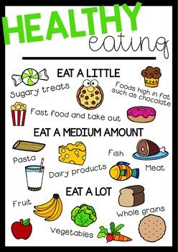
Poster

