Slide 1

Δήμητρα Καντζιούρα Α1
SAVE THE PLANET
Αρετή Φωτιάδου Α4

Slide 2
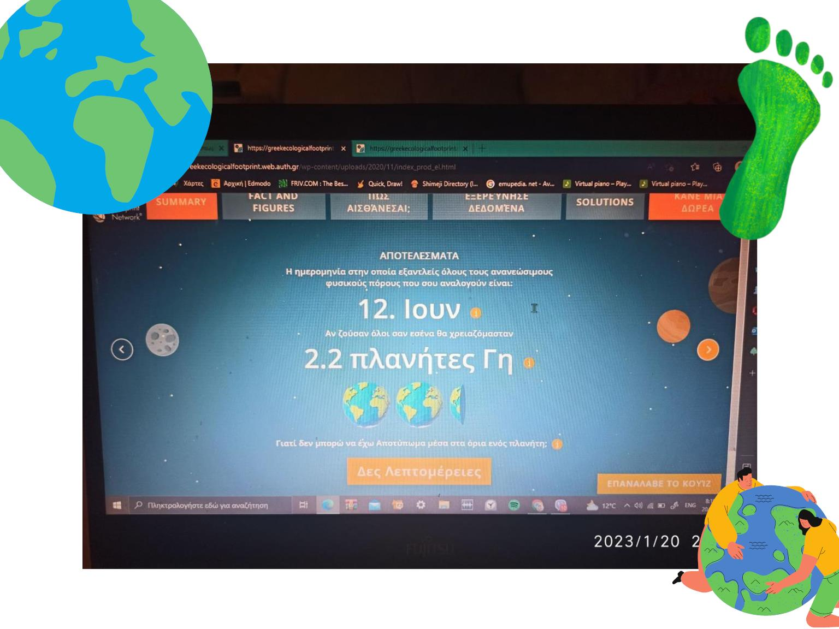
Αρετή Φωτιάδου Α4

Slide 3
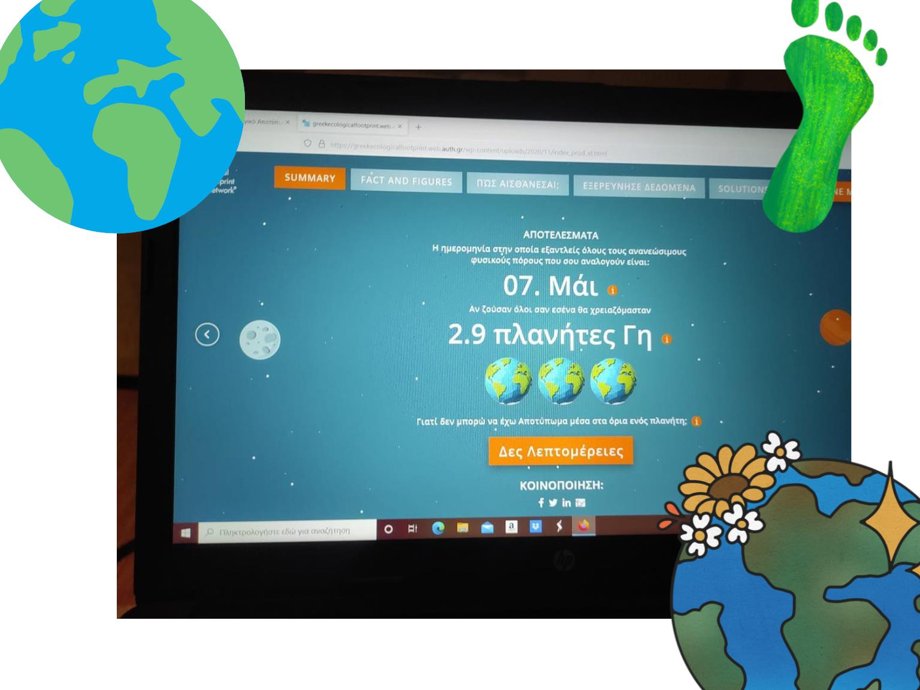
Δήμητρα Καντζιούρα Α1

Slide 4
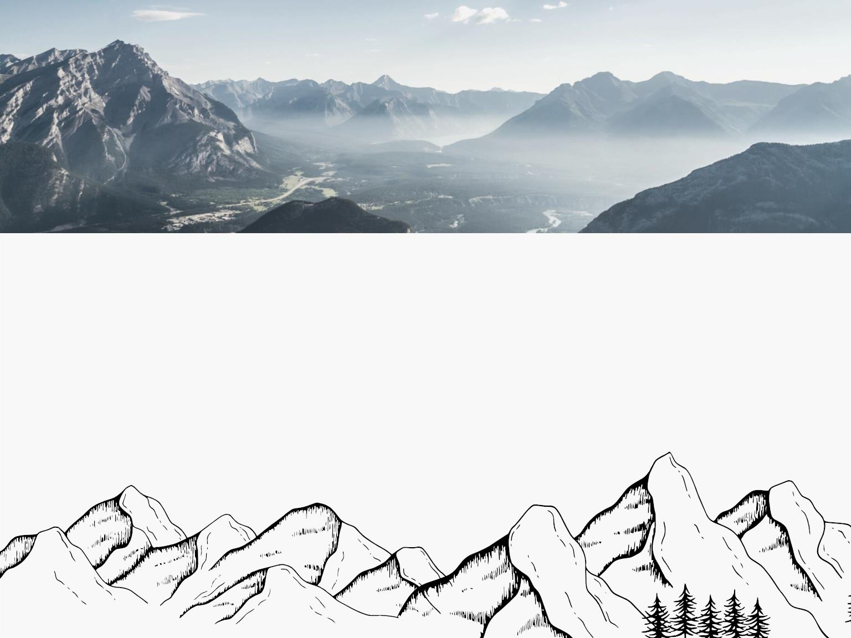
SOLUTIONS
wikipedia.org

Slide 5

CITY
To red
ution
se
from
you c
p blic
nd by
t,bike
walk instead.

Slide 6
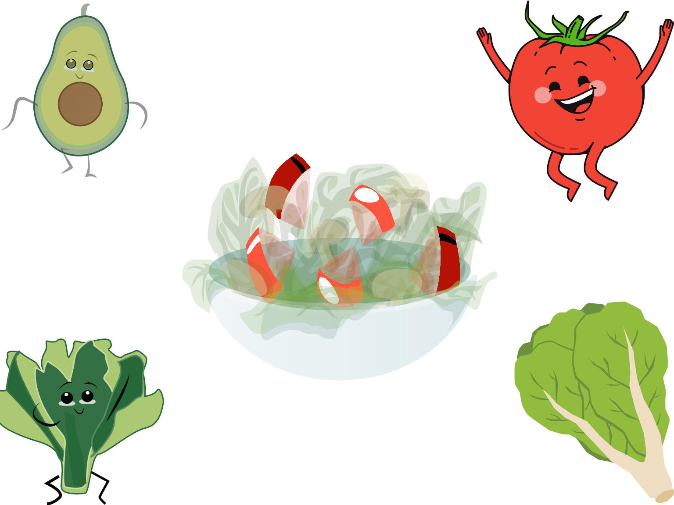
DIET
y
con
ood
by t
rian
cipe

Slide 7

Reduce, reu and recycle.
Cut down o t you throw
away. Fo w th three "R's"
to serve n ural
res s
spa e.
dfill

Slide 8

Volunt Vo er for
cleanu munity.
You c get in ved in
protecting your watershed,
too

Slide 9

onserve wate he less
water yo s e less
runoff an tewater that
eventu
up in the
n.

Slide 10

Don't
our w
toxic
als into
se non-
e home

Slide 11

Use long-lasting light bulbs.
Energy e
reduce
light bulbs
use gas
emissio o flip the
light switch off when you
leave room!

Slide 12

Shop ely. y less
plastic an a reusable
sho bag

Slide 13

USE YOUR VOICE
We are the firs eration to
know we’re d
and
the world,
st that can
Speaking
do
up is of
powerful
thing ou can specially if
it’s to the right people

Slide 14

FIND WAYS TO DONATE
There are lots of ways to
give. B
mber of
al, take
WWF, ad
on a chal for Team
Panda or encourage your
family
by setting up
birthday fundraiser.
nate
ok

Slide 15

We hope to see you soon!
THANK YOU!

