Slide 1
Green shopping guide
Here are some ideas with things to buy and alongside helping the environment

Slide 2
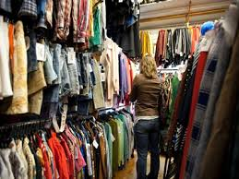
Second hand clothes

Slide 3
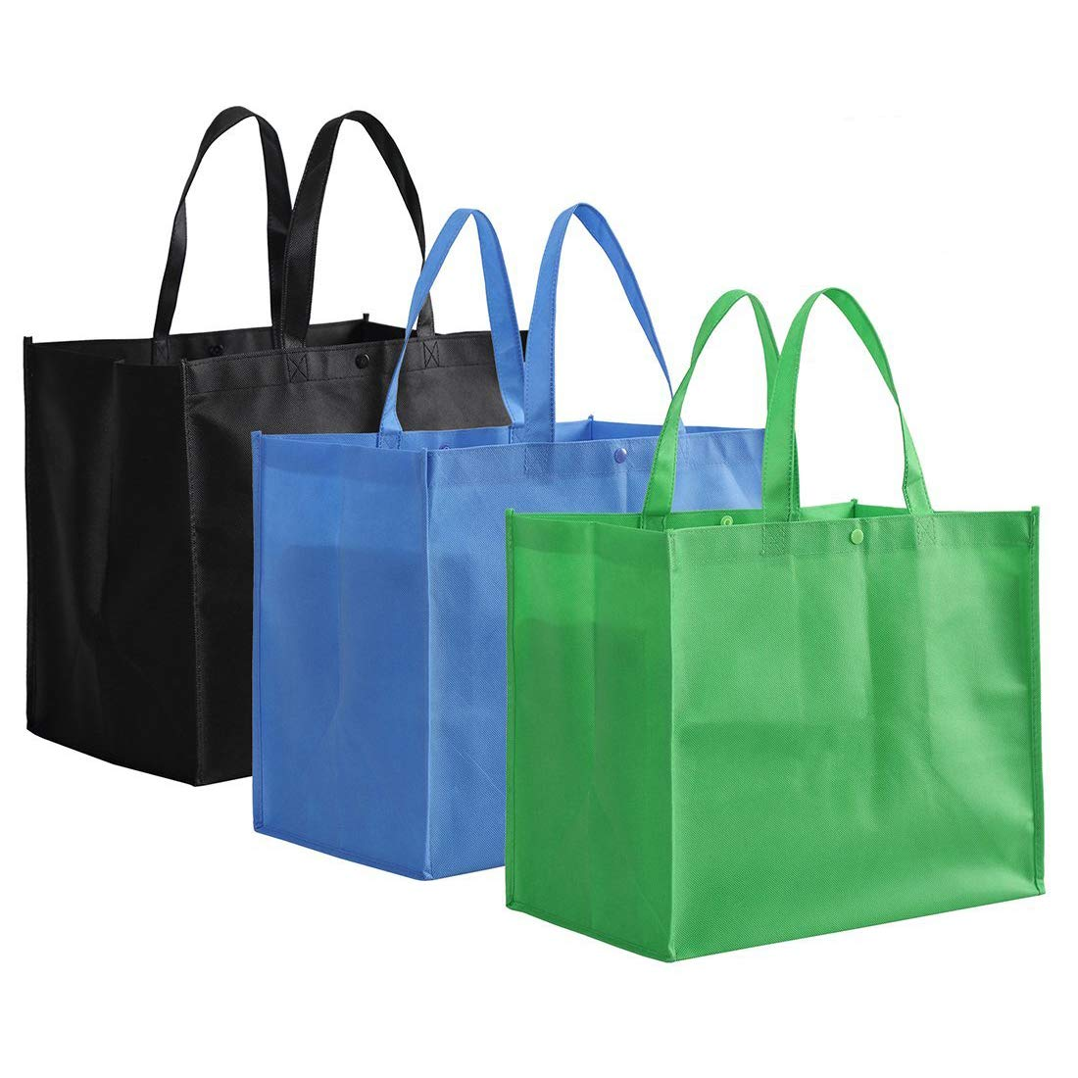
reusable shopping bags

Slide 4

Energy- efficient appliances

Slide 5
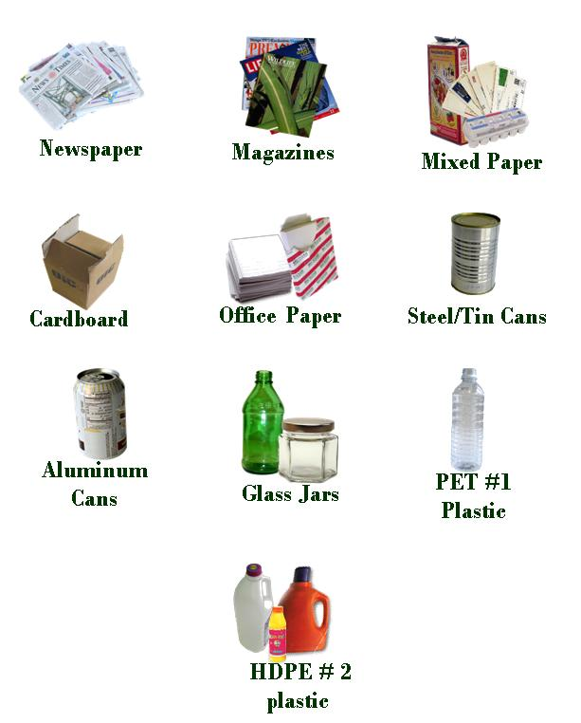
Recycled products

Slide 6
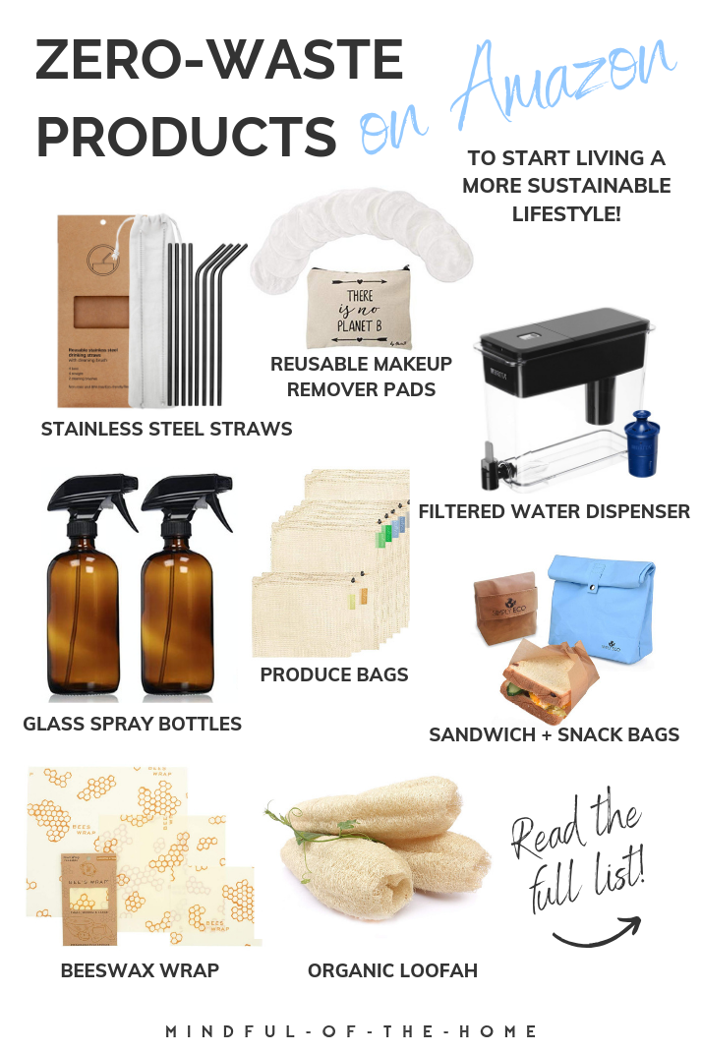
Zero-waste products

Slide 7
All this examples that I showed you can help the environment so much especially when you use them everyday.
They can be a little more expensive but we don’t need to waste so much products and this ideas are a more environmentally friendly to use.
Anthi Zacharia

